Slide 1
Chapter 29
Magnetic Fields

Slide 2
A Brief History of Magnetism
13th century BC
  Chinese used a compass
    Uses a magnetic needle
    Probably an invention of Arabic or Indian origin
800 BC
  Greeks
    Discovered magnetite (Fe₃O₄) attracts pieces of iron
Introduction

Slide 3
A Brief History of Magnetism, cont.
1269
  Pierre de Maricourt found that the direction of a needle near a spherical natural magnet formed lines that encircled the sphere .
  The lines also passed through two points diametrically opposed to each other.
  He called the points poles
1600
  William Gilbert
    Expanded experiments with magnetism to a variety of materials
    Suggested the Earth itself was a large permanent magnet
Introduction

Slide 4
A Brief History of Magnetism, final
1750
  Experimenters showed that magnetic poles exert attractive or repulsive forces on each other.
1819
  Found an electric current deflected a compass needle
1820’s
  Faraday and Henry
    Further connections between electricity and magnetism
    A changing magnetic field creates an electric field.
  Maxwell
    A changing electric field produces a magnetic field.
Introduction

Slide 5
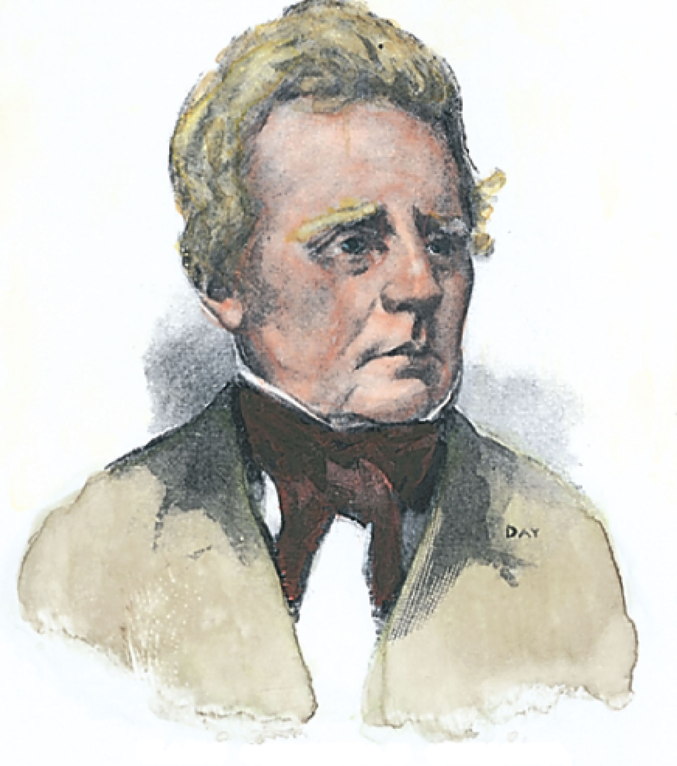
Hans Christian Oersted
1777 – 1851
Discovered the relationship between electricity and magnetism
An electric current in a wire deflected a nearby compass needle
The first evidence of the connection between electric and magnetic phenomena
Also the first to prepare pure aluminum
Introduction

Slide 6
Magnetic Poles
Every magnet, regardless of its shape, has two poles.
  Called north and south poles
  Poles exert forces on one another
    Similar to the way electric charges exert forces on each other
    Like poles repel each other
      N-N or S-S
    Unlike poles attract each other
      N-S
Introduction

Slide 7
Magnetic Poles, cont.
The poles received their names due to the way a magnet behaves in the Earth’s magnetic field.
If a bar magnet is suspended so that it can move freely, it will rotate.
  The magnetic north pole points toward the Earth’s north geographic pole.
    This means the Earth’s north geographic pole is a magnetic south pole.
    Similarly, the Earth’s south geographic pole is a magnetic north pole.
Introduction

Slide 8
Magnetic Poles, final
The force between two poles varies as the inverse square of the distance between them.
A single magnetic pole has never been isolated.
  In other words, magnetic poles are always found in pairs.
  All attempts so far to detect an isolated magnetic pole has been unsuccessful.
    No matter how many times a permanent magnetic is cut in two, each piece always has a north and south pole.
Introduction

Slide 9
Magnetic Fields
Reminder: an electric field surrounds any electric charge
The region of space surrounding any moving electric charge also contains a magnetic field.
A magnetic field also surrounds a magnetic substance making up a permanent magnet.
Section 29.1

Slide 10
Magnetic Fields, cont.
A vector quantity
Symbolized by
Direction is given by the direction a north pole of a compass needle points in that location
Magnetic field lines can be used to show how the field lines, as traced out by a compass, would look.
Section 29.1

Slide 11
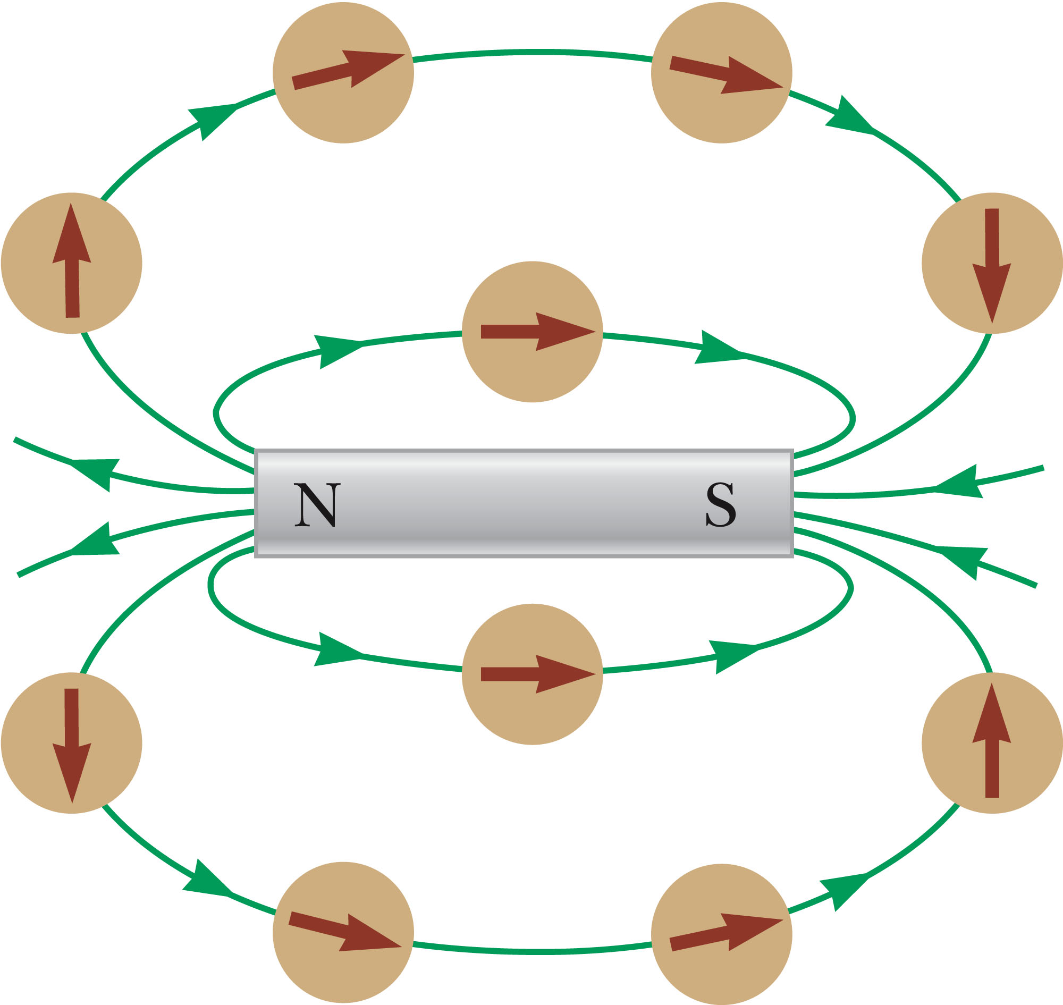
Magnetic Field Lines, Bar Magnet Example
The compass can be used to trace the field lines.
The lines outside the magnet point from the North pole to the South pole.
Section 29.1

Slide 12
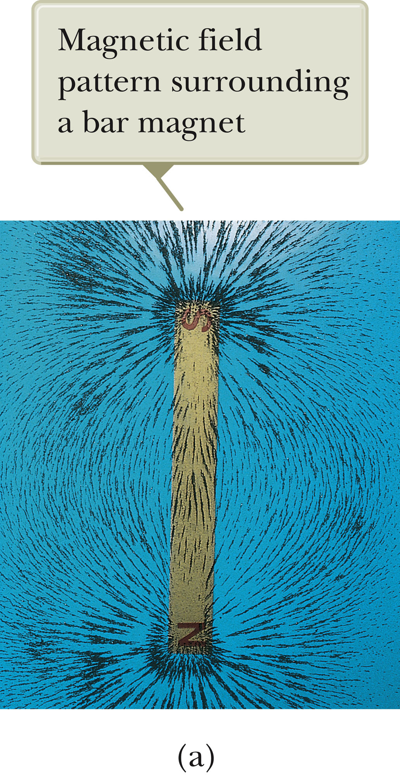
Magnetic Field Lines, Bar Magnet
Iron filings are used to show the pattern of the electric field lines.
The direction of the field is the direction a north pole would point.
Section 29.1

Slide 13
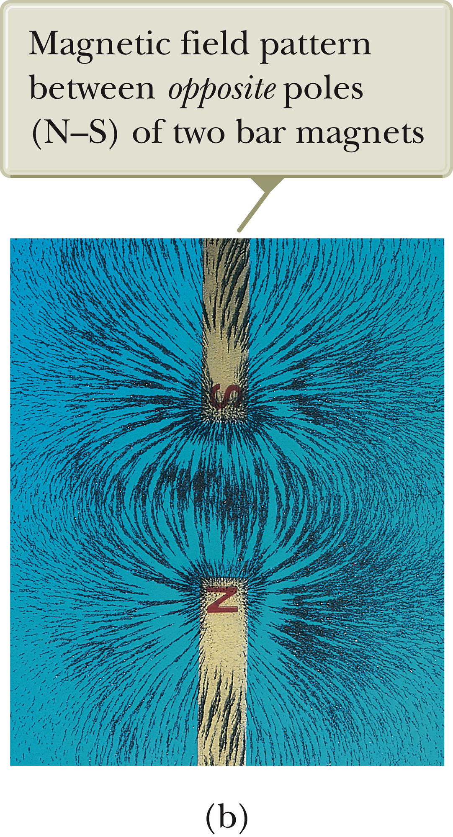
Magnetic Field Lines, Opposite Poles
Iron filings are used to show the pattern of the electric field lines.
The direction of the field is the direction a north pole would point.
  Compare to the electric field produced by an electric dipole
Section 29.1

Slide 14
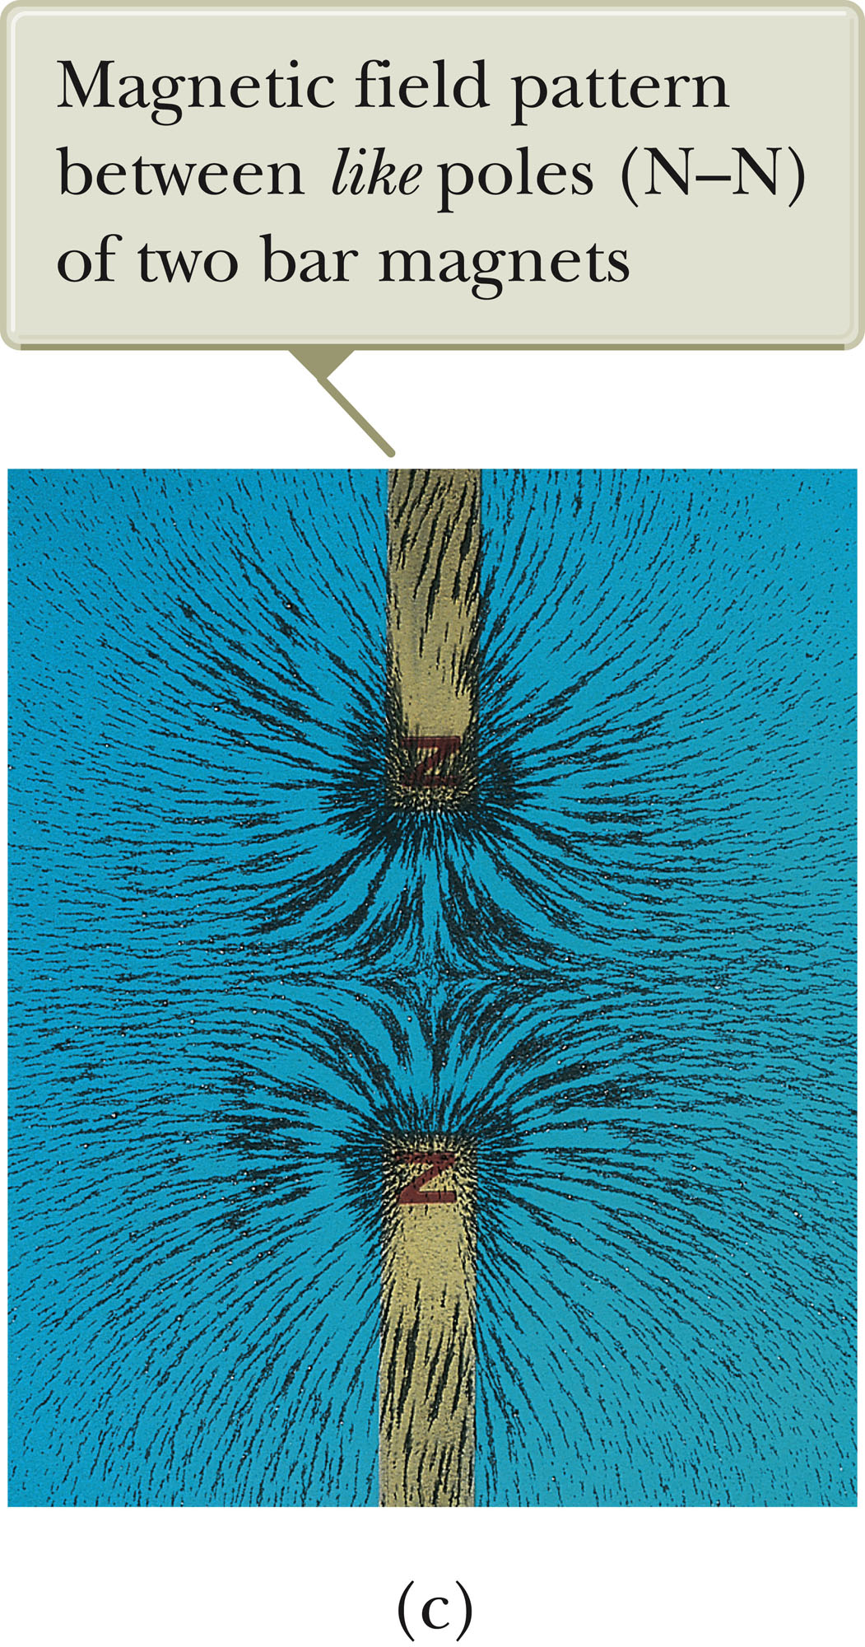
Magnetic Field Lines, Like Poles
Iron filings are used to show the pattern of the electric field lines.
The direction of the field is the direction a north pole would point.
  Compare to the electric field produced by like charges
Section 29.1

Slide 15
Earth’s Magnetic Poles
More proper terminology would be that a magnet has “north-seeking” and “south-seeking” poles.
The north-seeking pole points to the north geographic pole.
  This would correspond to the Earth’s south magnetic pole.
The south-seeking pole points to the south geographic pole.
  This would correspond to the Earth’s north magnetic pole.
The configuration of the Earth’s magnetic field is very much like the one that would be achieved by burying a gigantic bar magnet deep in the Earth’s interior.
Section 29.1

Slide 16
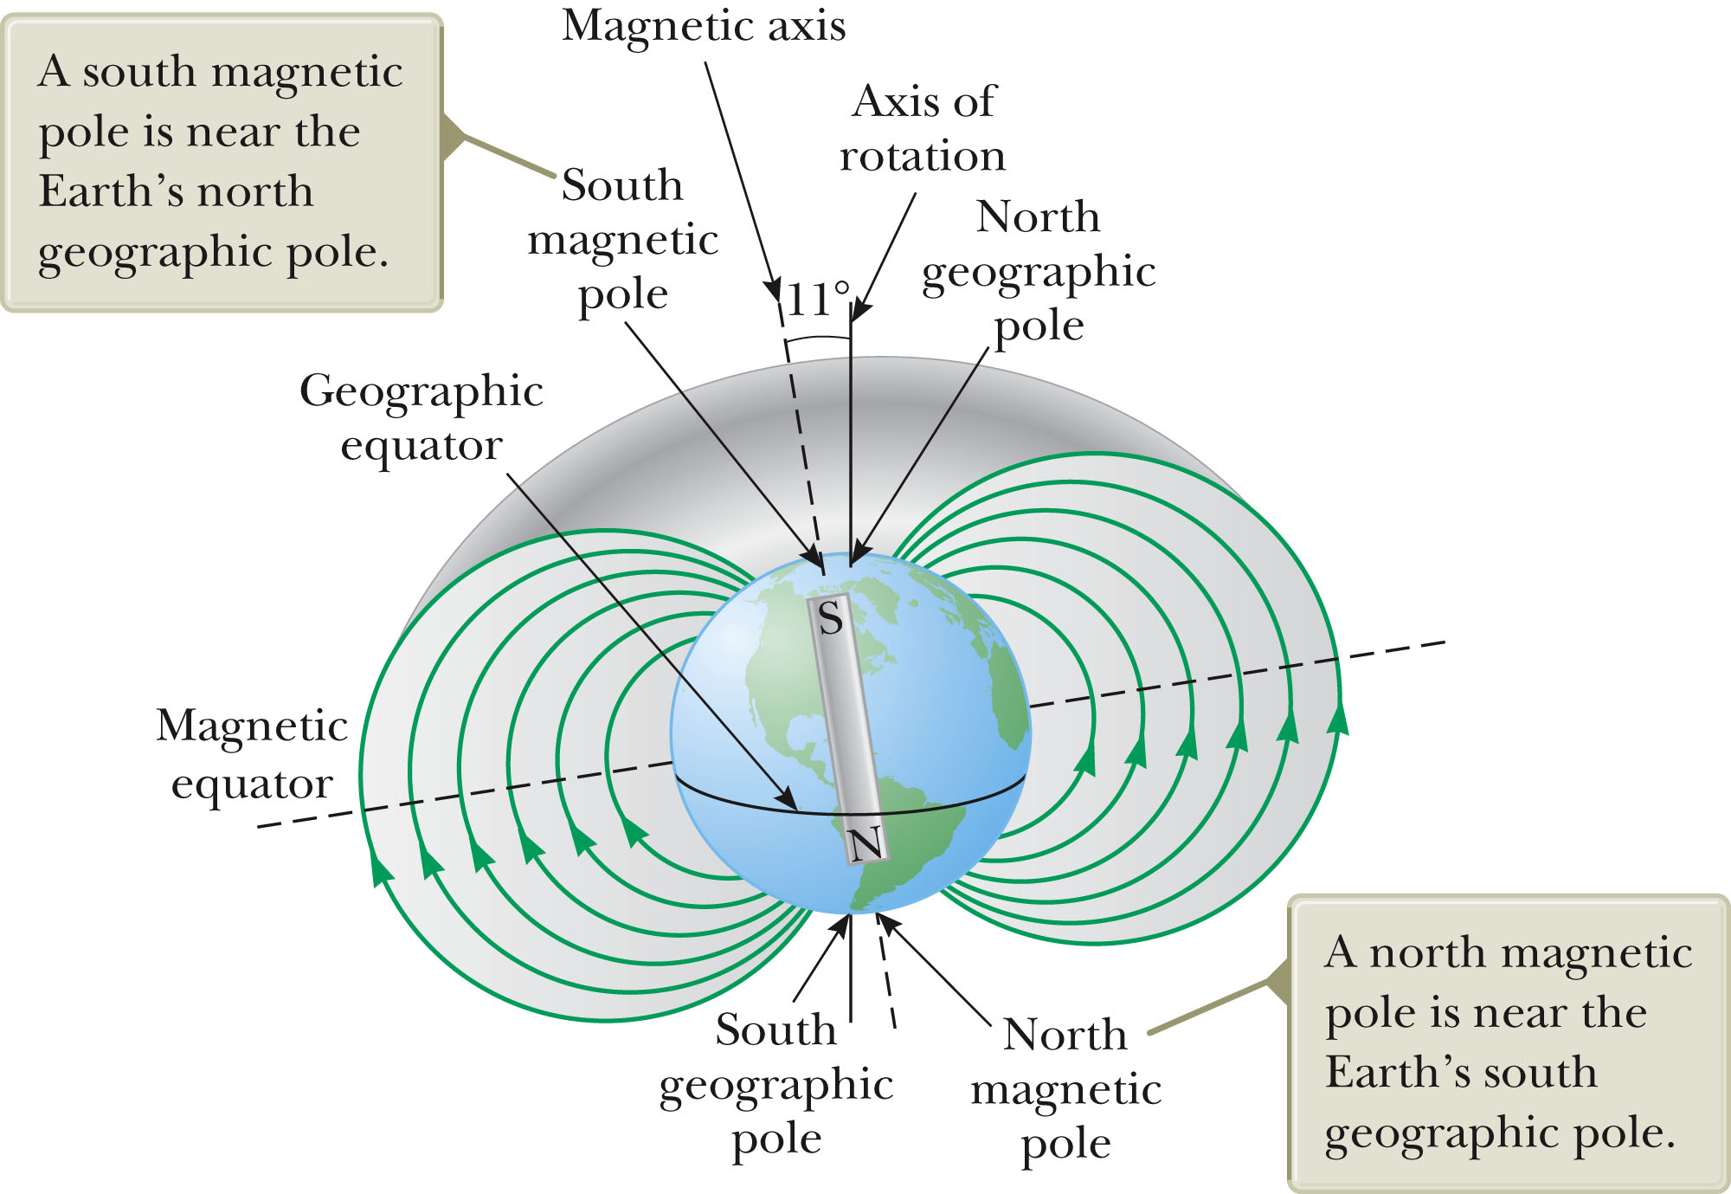
Earth’s Magnetic Field
The source of the Earth’s magnetic field is likely convection currents in the Earth’s core.
There is strong evidence that the magnitude of a planet’s magnetic field is related to its rate of rotation.
The direction of the Earth’s magnetic field reverses periodically.
Section 29.1

Slide 17
Definition of Magnetic Field
The magnetic field at some point in space can be defined in terms of the magnetic force, .
The magnetic force will be exerted on a charged particle moving with a velocity, .
  Assume (for now) there are no gravitational or electric fields present.
Section 29.1

Slide 18
Properties of a Force on a Charge Moving in a Magnetic Field
The magnitude F_{B} of the magnetic force exerted on the particle is proportional to the charge, q, and to the speed, v, of the particle.
When a charged particle moves parallel to the magnetic field vector, the magnetic force acting on the particle is zero.
When the particle’s velocity vector makes any angle θ ≠ 0 with the field, the force acts in a direction perpendicular to the plane formed by the velocity and the field.
The magnetic force exerted on a positive charge is in the direction opposite the direction of the magnetic force exerted on a negative charge moving in the same direction.
The magnitude of the magnetic force is proportional to sin θ, where θ is the angle the particle’s velocity makes with the direction of the magnetic field.
Section 29.1

Slide 19
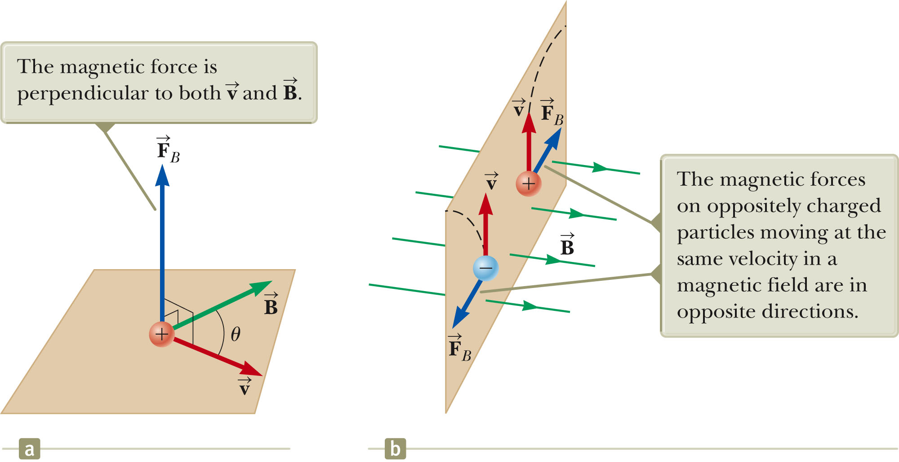
More About Direction
Section 29.1

Slide 20
Force on a Charge Moving in a Magnetic Field, Formula
The properties can be summarized in a vector equation:
  is the magnetic force
  q is the charge
  is the velocity of the moving charge
  is the magnetic field
Section 29.1

Slide 21
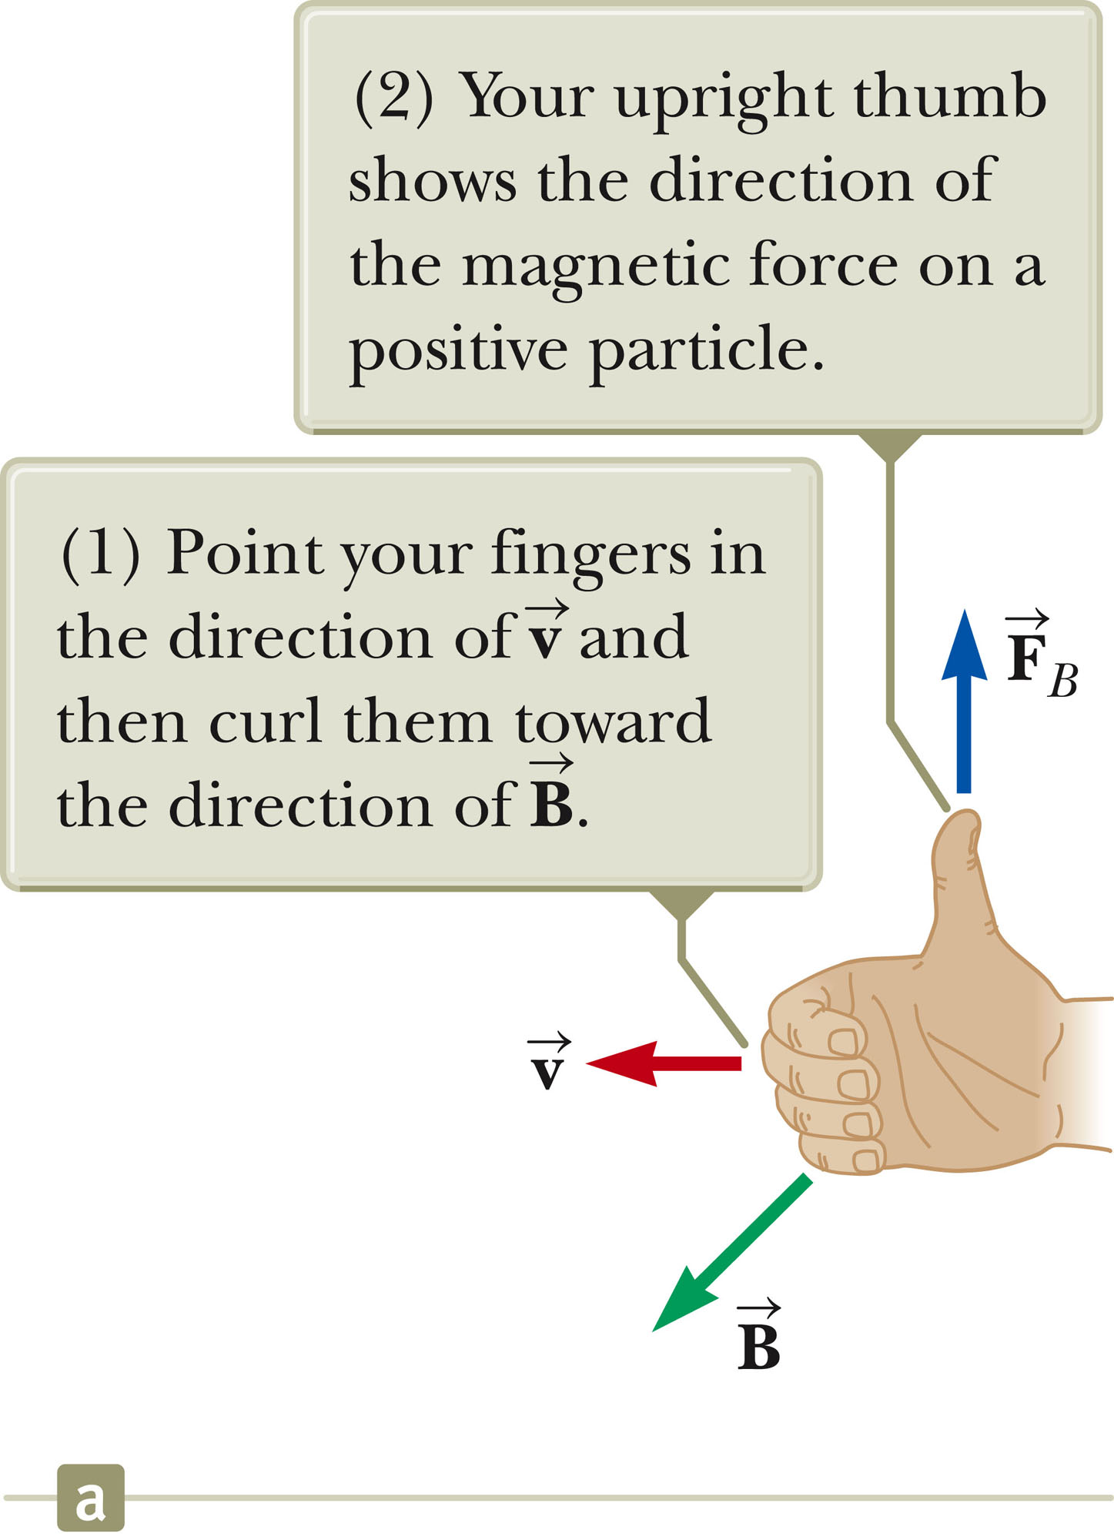
Direction: Right-Hand Rule #1
This rule is based on the right-hand rule for the cross product.
Your thumb is in the direction of the force if q is positive.
The force is in the opposite direction of your thumb if q is negative.
Section 29.1

Slide 22
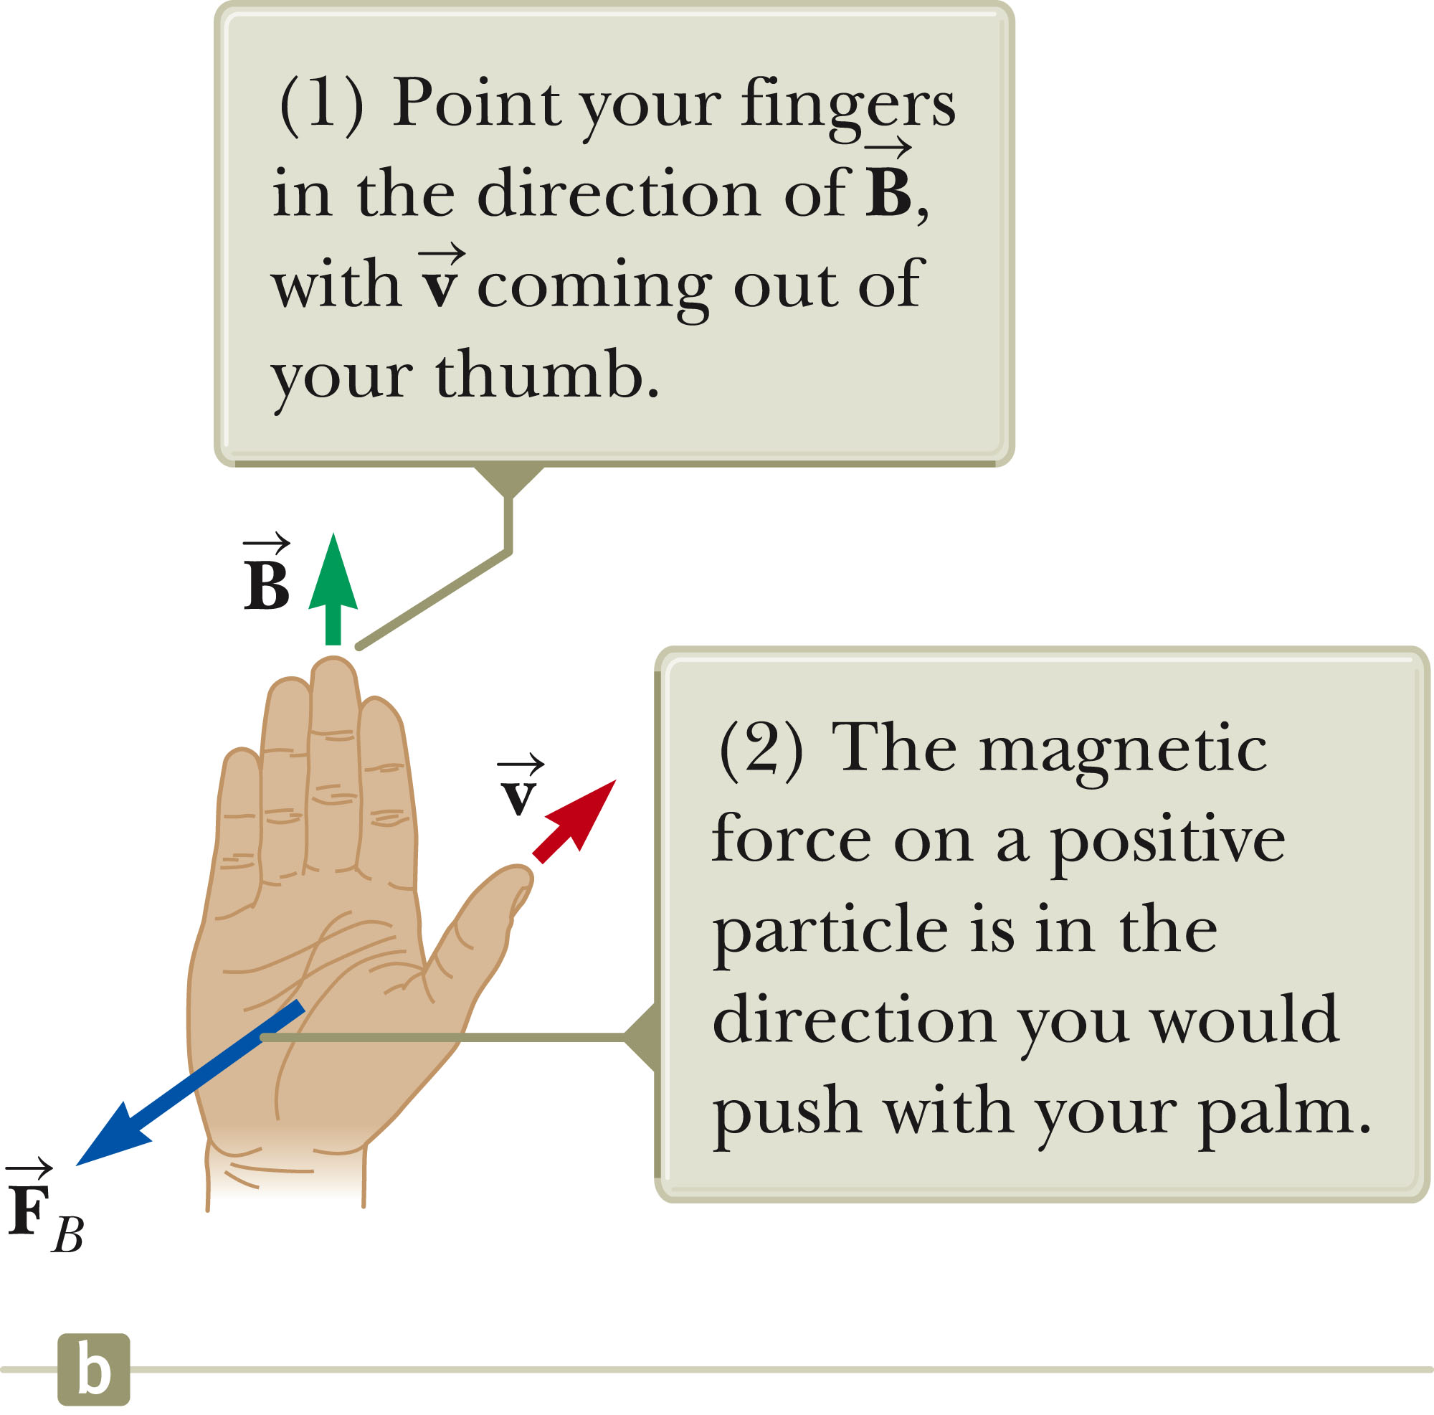
Direction: Right-Hand Rule #2
Alternative to Rule #1
The force on a positive charge extends outward from the palm.
The advantage of this rule is that the force on the charge is in the direction you would push on something with your hand.
The force on a negative charge is in the opposite direction.
Section 29.1

Slide 23
More About Magnitude of F
The magnitude of the magnetic force on a charged particle is F_{B} = |q| v B sin θ.
  θ is the smaller angle between v and B
  F_{B} is zero when the field and velocity are parallel or antiparallel
    θ = 0 or 180º
  F_{B} is a maximum when the field and velocity are perpendicular
    θ = 90º
Section 29.1

Slide 24
Differences Between Electric and Magnetic Fields
Direction of force
  The electric force acts along the direction of the electric field.
  The magnetic force acts perpendicular to the magnetic field.
Motion
  The electric force acts on a charged particle regardless of whether the particle is moving.
  The magnetic force acts on a charged particle only when the particle is in motion.
Work
  The electric force does work in displacing a charged particle.
  The magnetic force associated with a steady magnetic field does no work when a particle is displaced.
    This is because the force is perpendicular to the displacement of its point of application.
Section 29.1

Slide 25
Work in Fields, cont.
The kinetic energy of a charged particle moving through a magnetic field cannot be altered by the magnetic field alone.
When a charged particle moves with a given velocity through a magnetic field, the field can alter the direction of the velocity, but not the speed or the kinetic energy.
Section 29.1

Slide 26
Units of Magnetic Field
The SI unit of magnetic field is the tesla (T).
  Wb is a weber
A non-SI commonly used unit is a gauss (G).
  1 T = 10⁴ G
Section 29.1

Slide 27
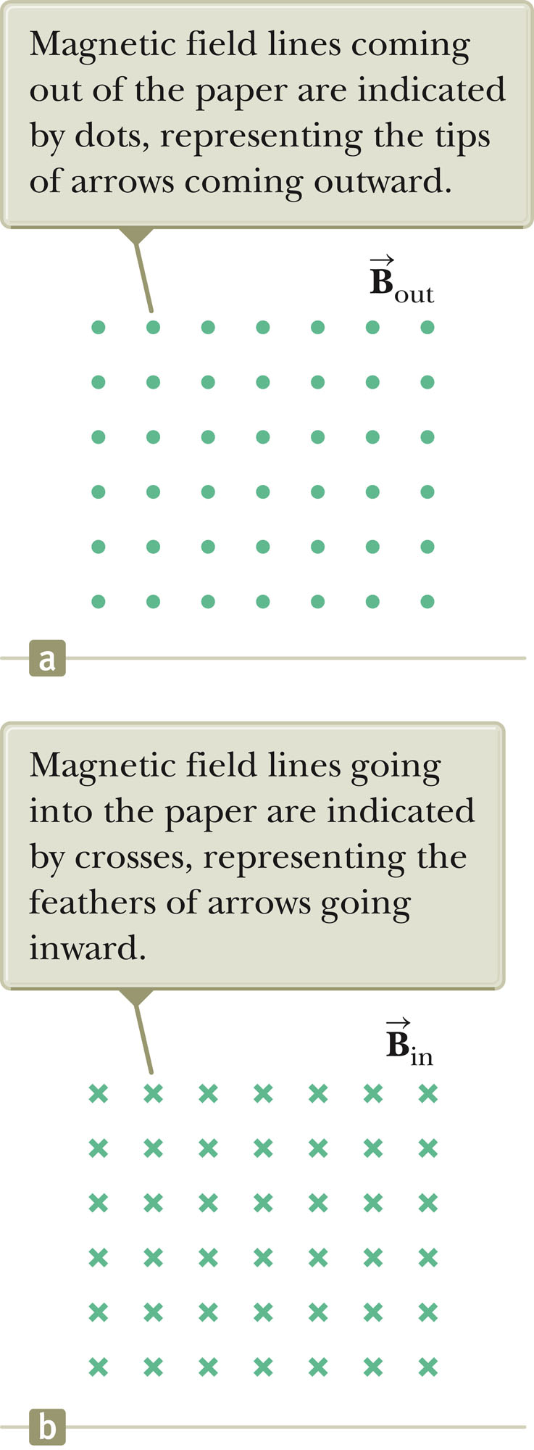
Notation Notes
When vectors are perpendicular to the page, dots and crosses are used.
  The dots represent the arrows coming out of the page.
  The crosses represent the arrows going into the page.
The same notation applies to other vectors.
Section 29.2

Slide 28
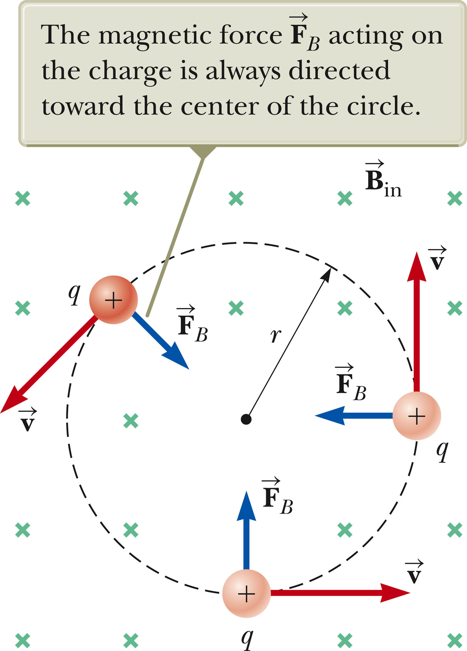
Charged Particle in a Magnetic Field
Consider a particle moving in an external magnetic field with its velocity perpendicular to the field.
The force is always directed toward the center of the circular path.
The magnetic force causes a centripetal acceleration, changing the direction of the velocity of the particle.
Section 29.2

Slide 29
Force on a Charged Particle
Use the particle under a net force and a particle in uniform circular motion models.
Equating the magnetic and centripetal forces:
Solving for r:
  r is proportional to the linear momentum of the particle and inversely proportional to the magnetic field.
Section 29.2

Slide 30
More About Motion of Charged Particle
The angular speed of the particle is
  The angular speed, ω, is also referred to as the cyclotron frequency.
The period of the motion is
Section 29.2

Slide 31
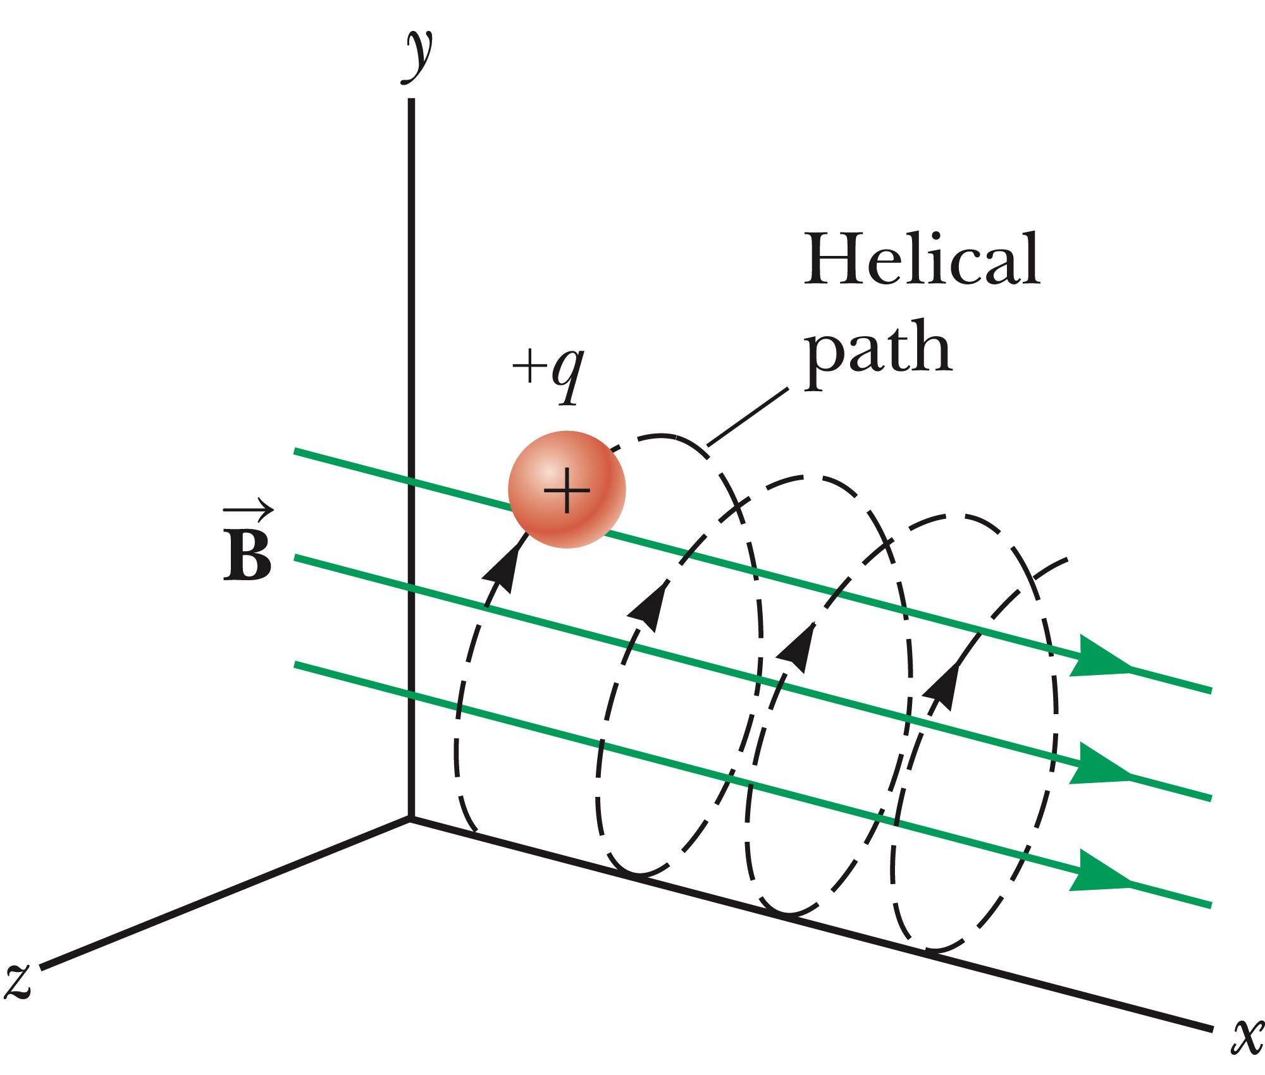
Motion of a Particle, General
If a charged particle moves in a magnetic field at some arbitrary angle with respect to the field, its path is a helix.
Same equations apply, with v replaced by
Section 29.2

Slide 32
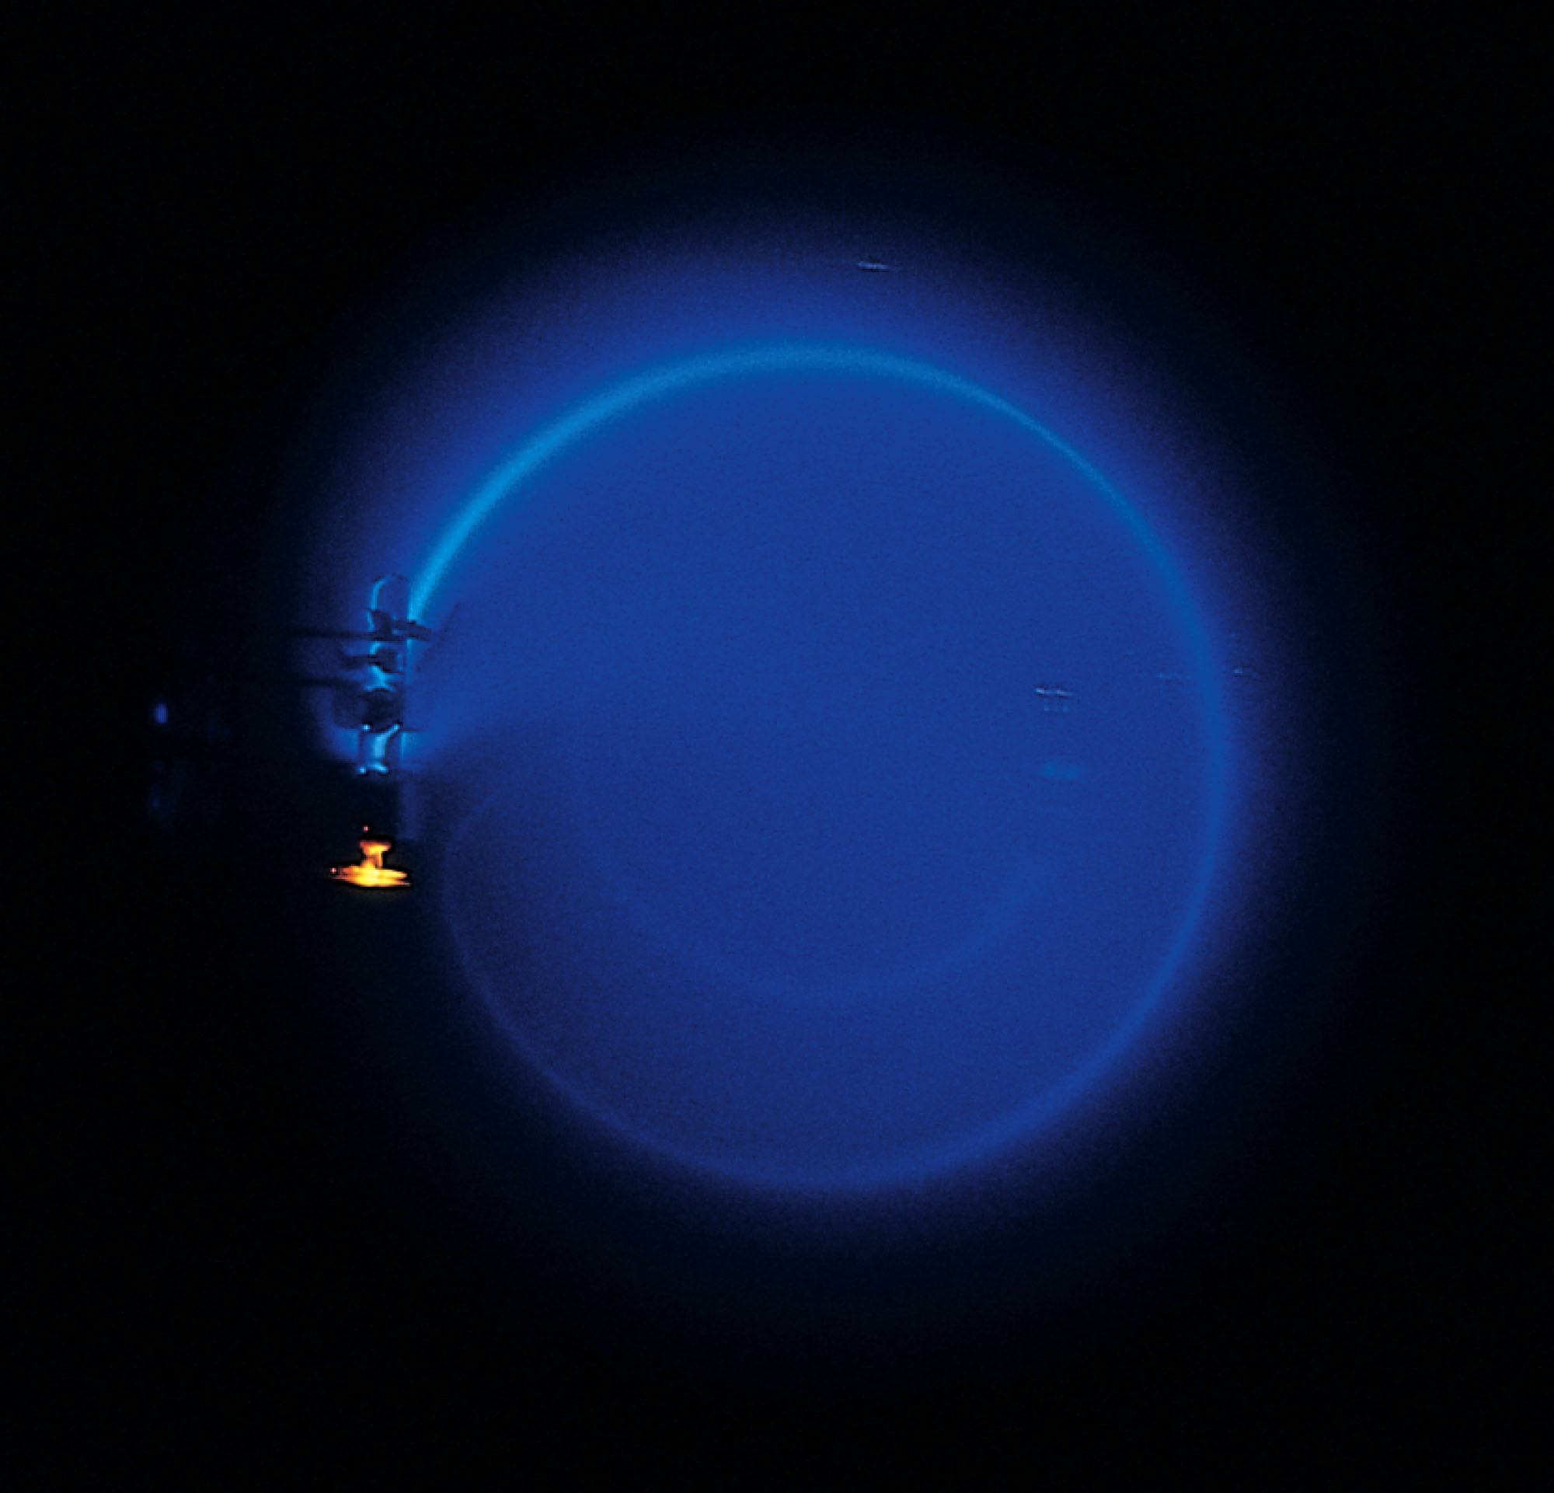
Bending of an Electron Beam
Electrons are accelerated from rest through a potential difference.
The electrons then enter a uniform magnetic field that is perpendicular to the velocity vector.
The electrons travel in a curved path.
Conservation of energy will give v
Other parameters can be found
Section 29.2

Slide 33
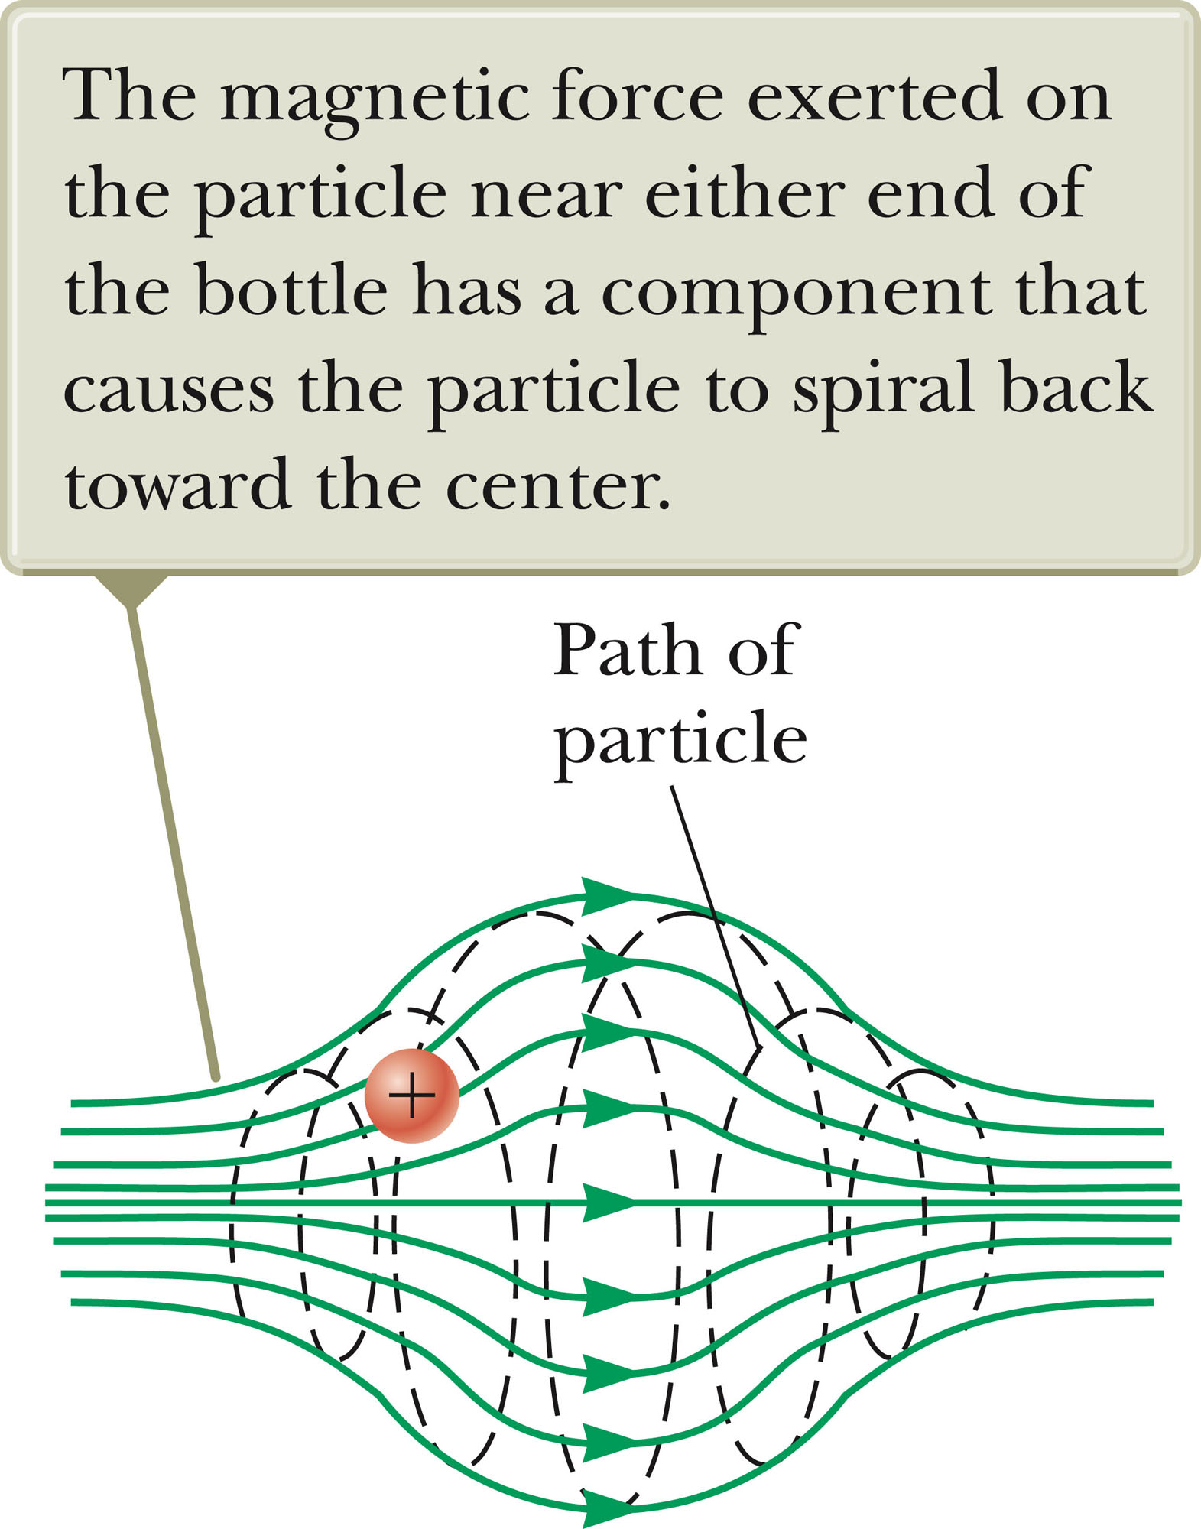
Particle in a Nonuniform Magnetic Field
The motion is complex.
For example, the particles can oscillate back and forth between two positions.
This configuration is known as a magnetic bottle.
Section 29.2

Slide 34
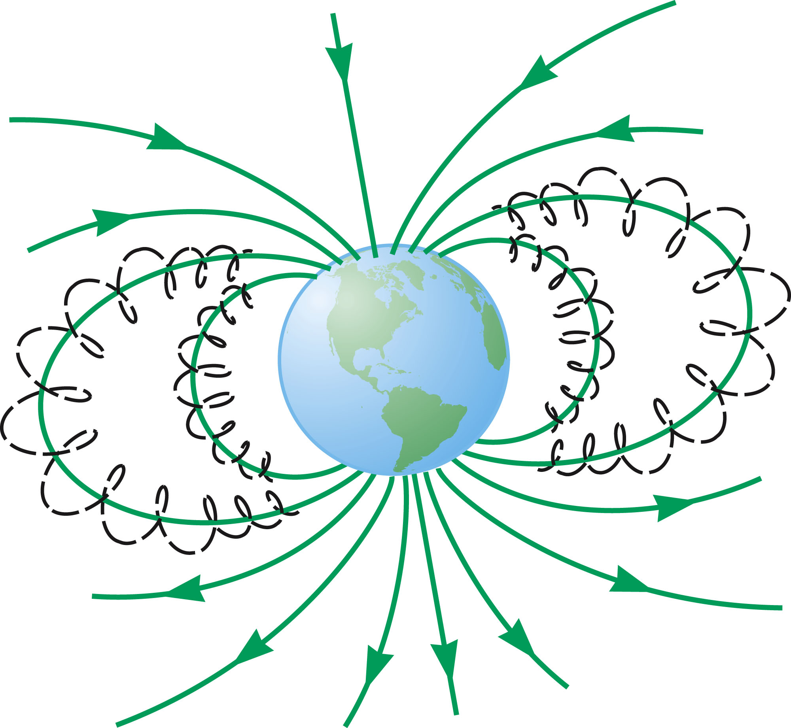
Van Allen Radiation Belts
The Van Allen radiation belts consist of charged particles surrounding the Earth in doughnut-shaped regions.
The particles are trapped by the Earth’s nonuniform magnetic field.
The particles spiral from pole to pole.
  May result in auroras
Section 29.2

Slide 35
Charged Particles Moving in Electric and Magnetic Fields
In many applications, charged particles will move in the presence of both magnetic and electric fields.
In that case, the total force is the sum of the forces due to the individual fields.
  The total force is called the Lorentz force.
In general:
Section 29.3

Slide 36
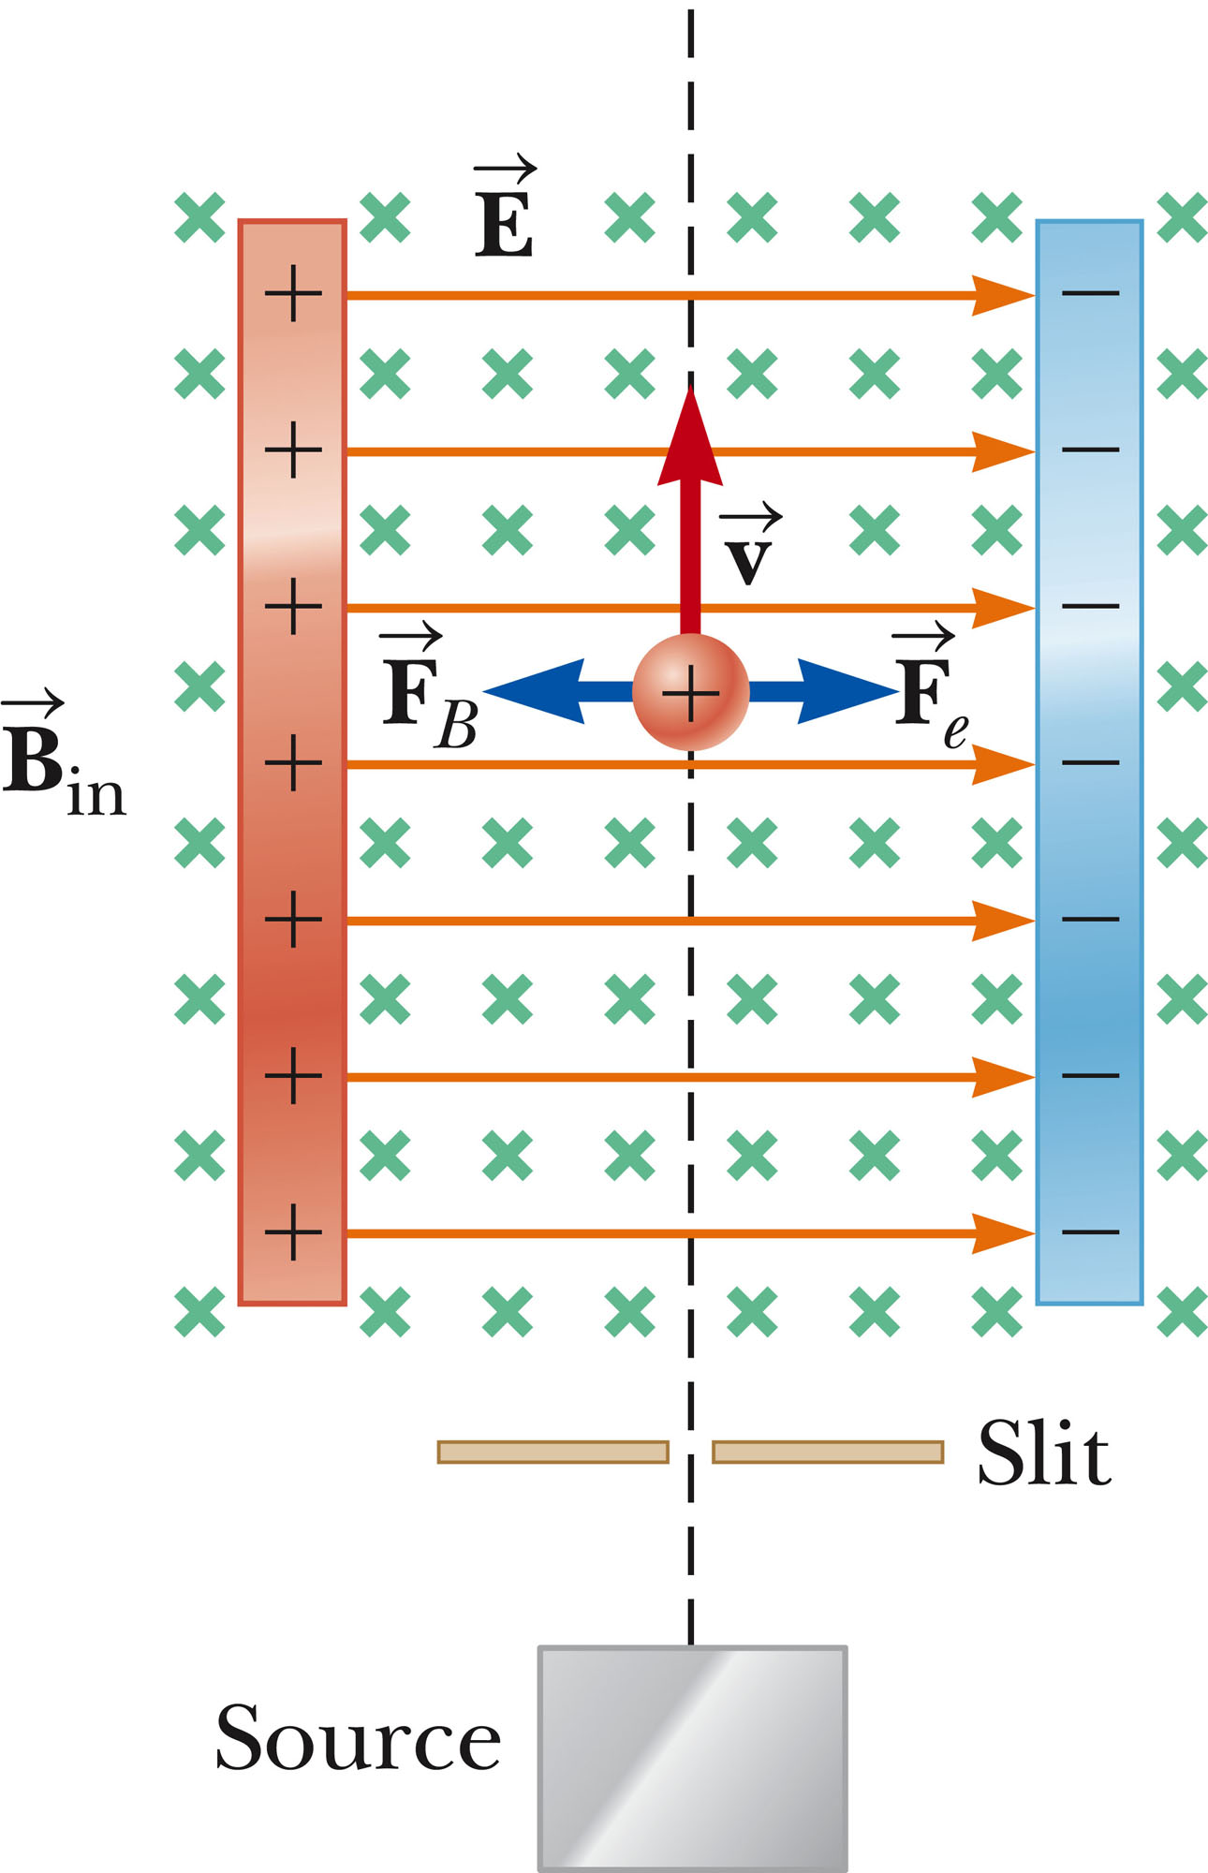
Velocity Selector
Used when all the particles need to move with the same velocity.
A uniform electric field is perpendicular to a uniform magnetic field.
When the force due to the electric field is equal but opposite to the force due to the magnetic field, the particle moves in a straight line.
This occurs for velocities of value.
v = E / B
Section 29.3

Slide 37
Velocity Selector, cont.
Only those particles with the given speed will pass through the two fields undeflected.
The magnetic force exerted on particles moving at a speed greater than this is stronger than the electric field and the particles will be deflected to the left.
Those moving more slowly will be deflected to the right.
Section 29.3

Slide 38
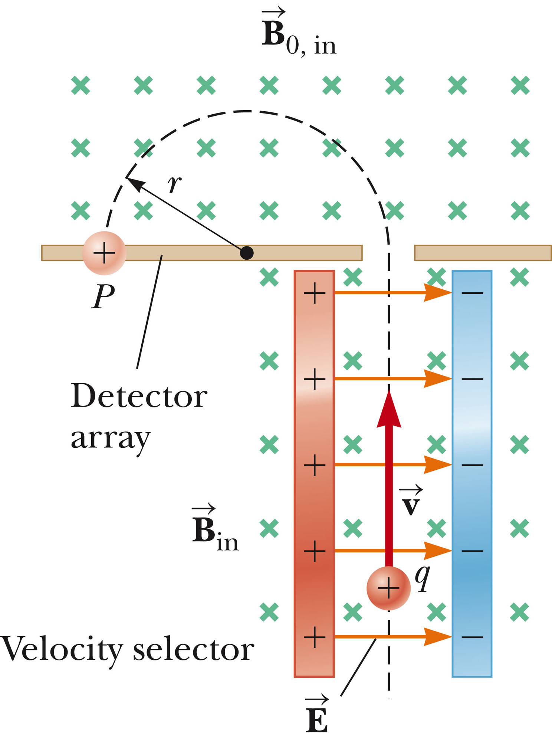
Mass Spectrometer
A mass spectrometer separates ions according to their mass-to-charge ratio.
In one design, a beam of ions passes through a velocity selector and enters a second magnetic field.
After entering the second magnetic field, the ions move in a semicircle of radius r before striking a detector at P.
If the ions are positively charged, they deflect to the left.
If the ions are negatively charged, they deflect to the right.
Section 29.3

Slide 39
Mass Spectrometer, cont.
The mass to charge (m/q) ratio can be determined by measuring the radius of curvature and knowing the magnetic and electric field magnitudes.
In practice, you can measure the masses of various isotopes of a given atom, with all the ions carrying the same charge.
  The mass ratios can be determined even if the charge is unknown.
Section 29.3

Slide 40
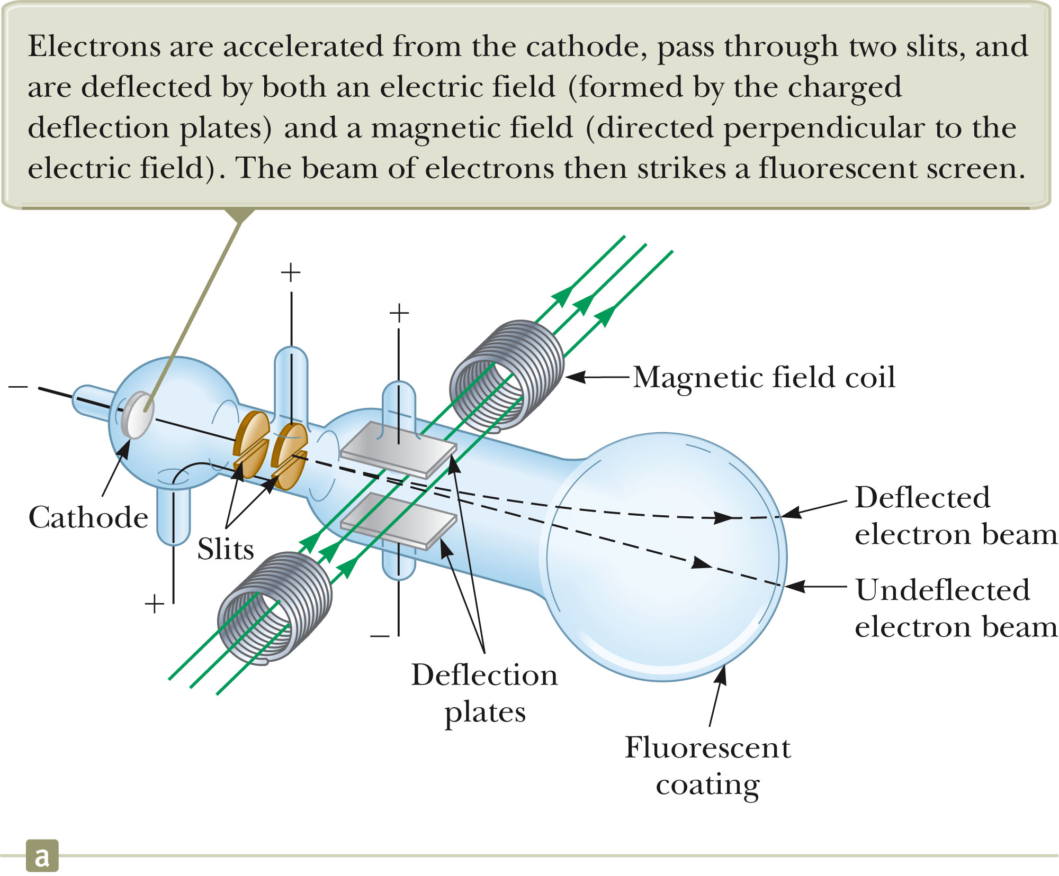
Thomson’s e/m Experiment
Electrons are accelerated from the cathode.
They are deflected by electric and magnetic fields.
The beam of electrons strikes a fluorescent screen.
e/m was measured
Section 29.3

Slide 41
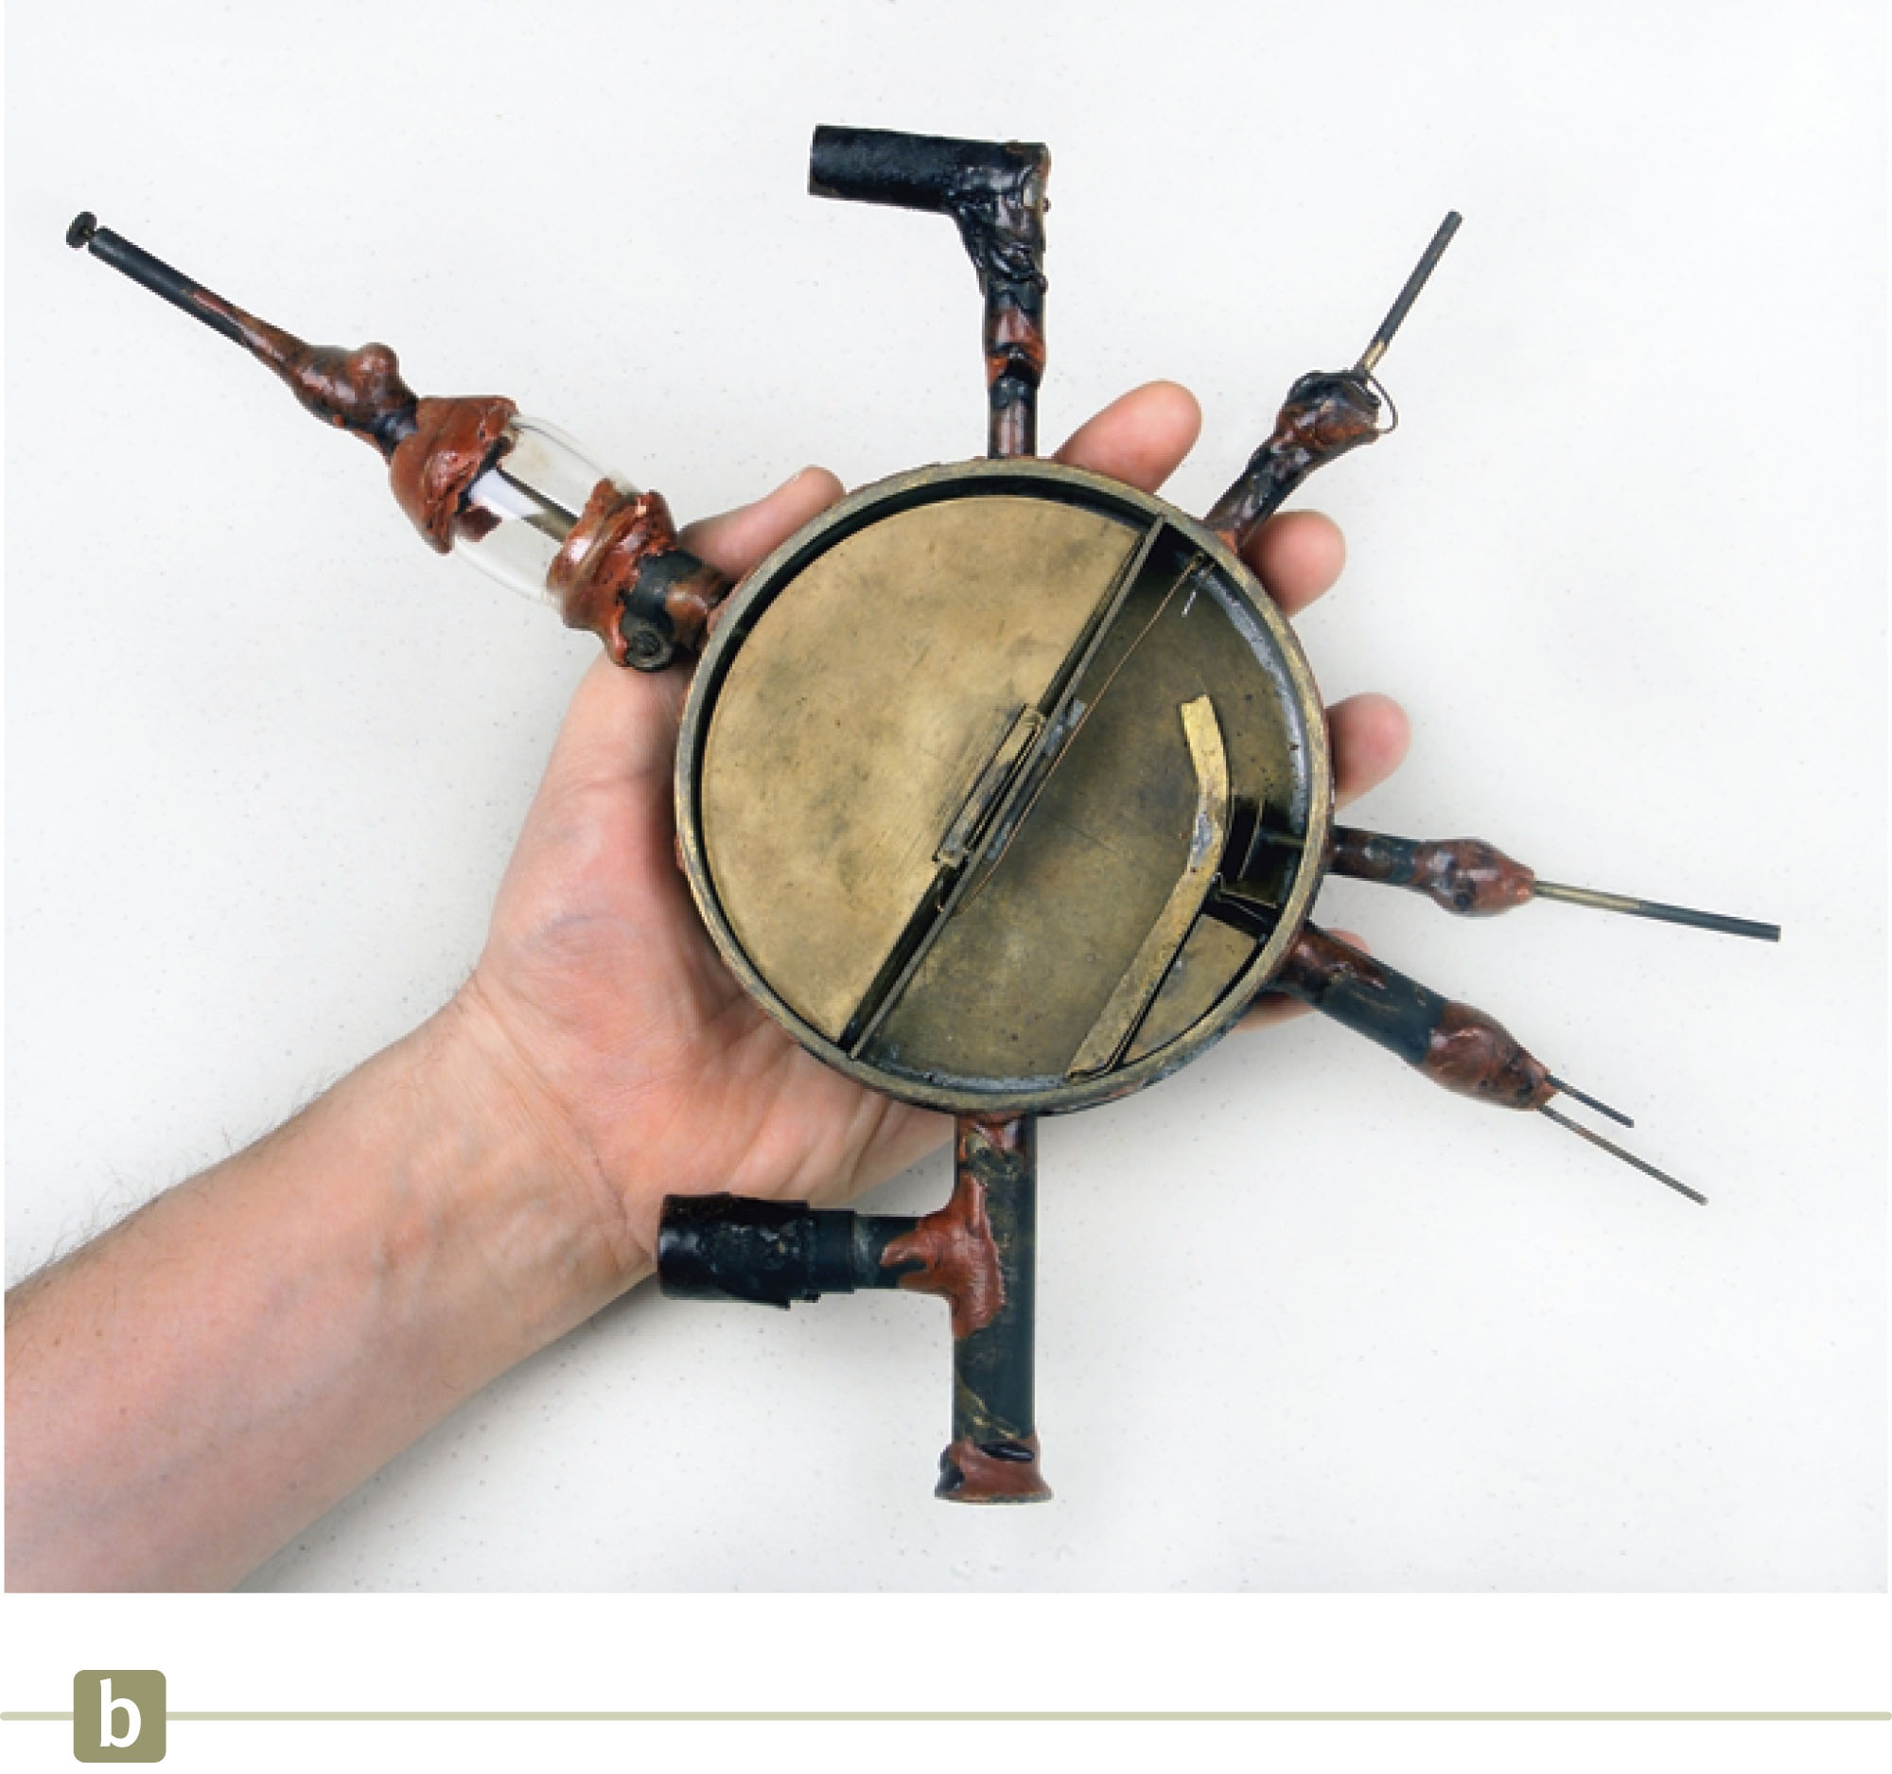
Cyclotron
A cyclotron is a device that can accelerate charged particles to very high speeds.
The energetic particles produced are used to bombard atomic nuclei and thereby produce reactions.
These reactions can be analyzed by researchers.
Section 29.3

Slide 42
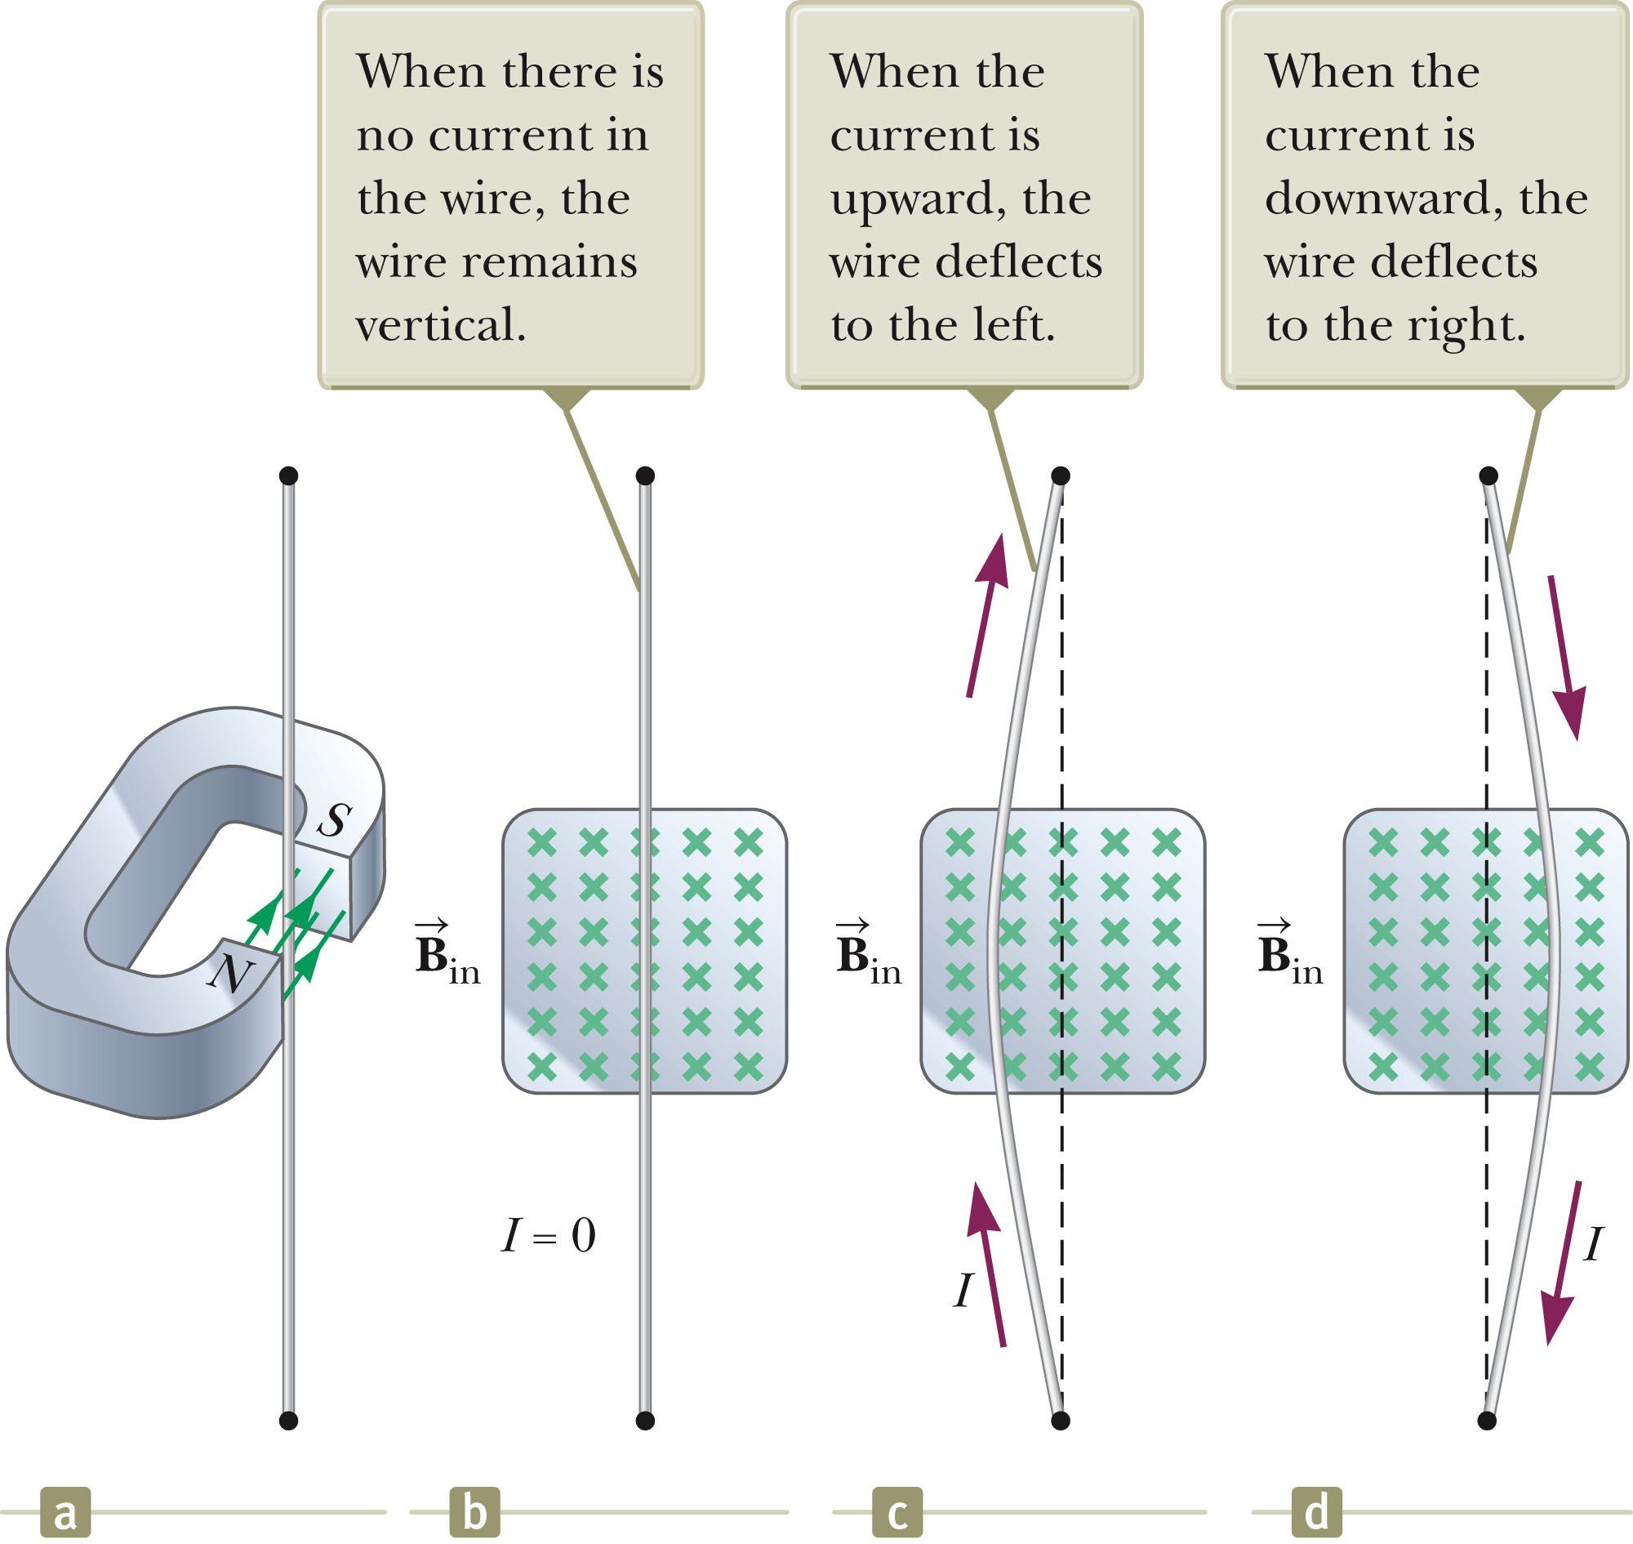
Cyclotron, cont.
D₁ and D₂ are called dees because of their shape.
A high frequency alternating potential is applied to the dees.
A uniform magnetic field is perpendicular to them.
A positive ion is released near the center and moves in a semicircular path.
Section 29.3

Slide 43
Cyclotron, final
The potential difference is adjusted so that the polarity of the dees is reversed in the same time interval as the particle travels around one dee.
This ensures the kinetic energy of the particle increases each trip.
The cyclotron’s operation is based on the fact that T is independent of the speed of the particles and of the radius of their path.
When the energy of the ions in a cyclotron exceeds about 20 MeV, relativistic effects come into play.
Most accelerators currently used in research are synchrotrons.
Section 29.3

Slide 44
Magnetic Force on a Current Carrying Conductor
A force is exerted on a current-carrying wire placed in a magnetic field.
  The current is a collection of many charged particles in motion.
The direction of the force is given by the right-hand rule.
Section 29.4

Slide 45
Force on a Wire
In this case, there is no current, so there is no force.
Therefore, the wire remains vertical.
Section 29.4

Slide 46
Force on a Wire, 2
The magnetic field is into the page
The current is up the page
The force is to the left
The wire deflects to the left
Section 29.4

Slide 47
Force on a Wire, 3
The magnetic field is into the page
The current is down the page
The force is to the right
The wire deflects to the right

Slide 48
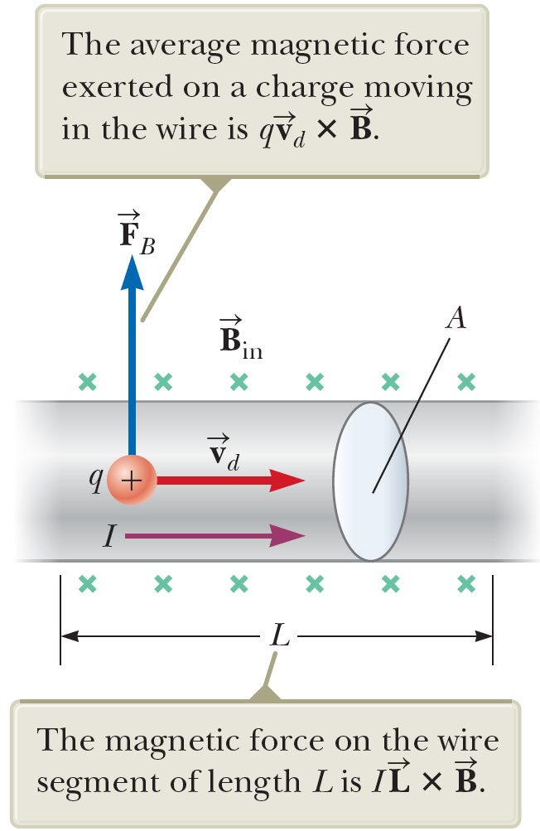
Force on a Wire, equation
The magnetic force is exerted on each moving charge in the wire.
The total force is the product of the force on one charge and the number of charges.
Section 29.4

Slide 49
Force on a Wire, Equation cont.
In terms of the current, this becomes
  I is the current.
  is a vector that points in the direction of the current.
    Its magnitude is the length L of the segment.
  is the magnetic field.
Section 29.4

Slide 50
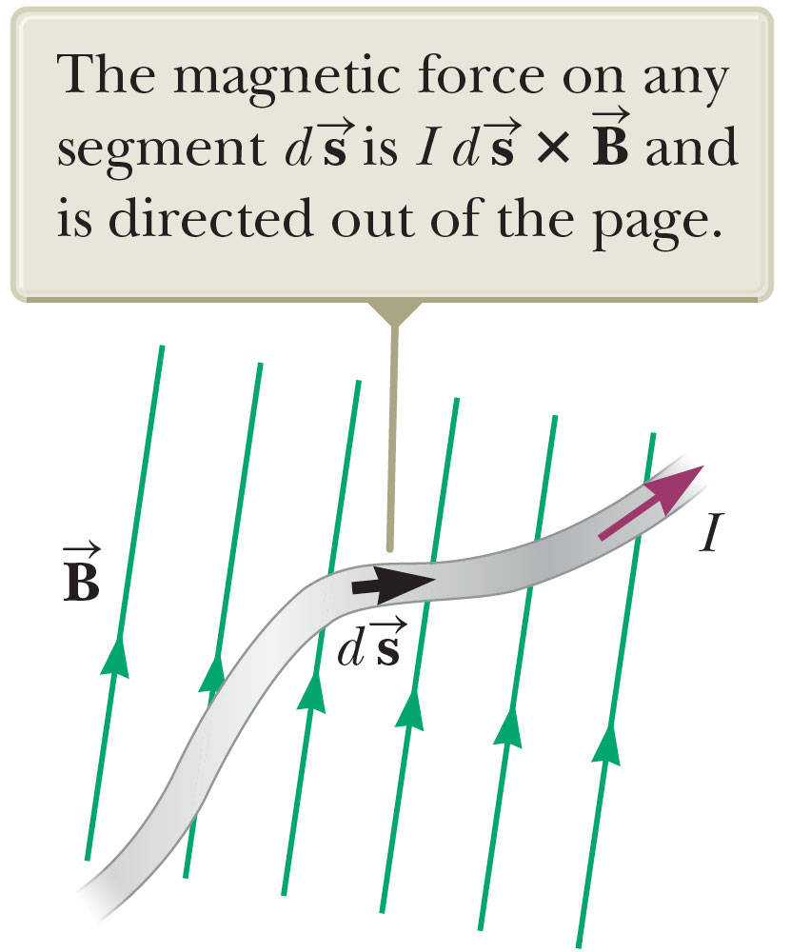
Force on a Wire, Arbitrary Shape
Consider a small segment of the wire,
The force exerted on this segment is
The total force is
Section 29.4

Slide 51
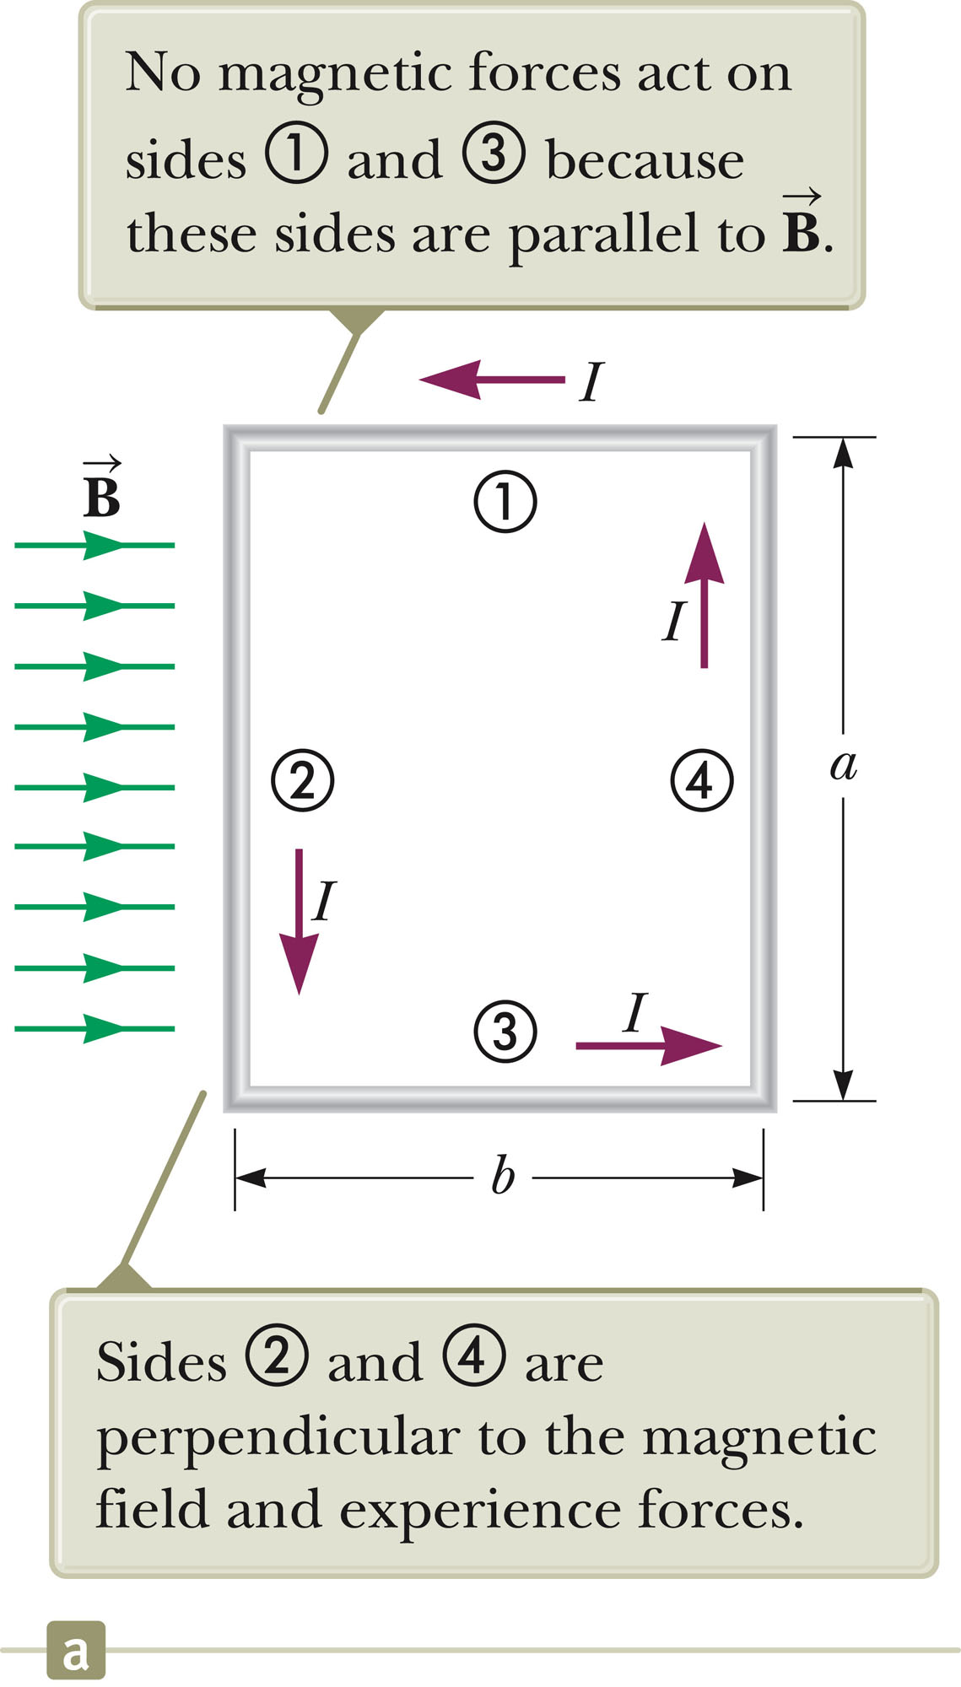
Torque on a Current Loop
The rectangular loop carries a current I in a uniform magnetic field.
No magnetic force acts on sides 1 & 3.
  The wires are parallel to the field and
Section 29.5

Slide 52
Torque on a Current Loop, 2
There is a force on sides 2 & 4 since they are perpendicular to the field.
The magnitude of the magnetic force on these sides will be:
  F₂ = F₄ = I a B
The direction of F₂ is out of the page.
The direction of F₄ is into the page.
Section 29.5

Slide 53
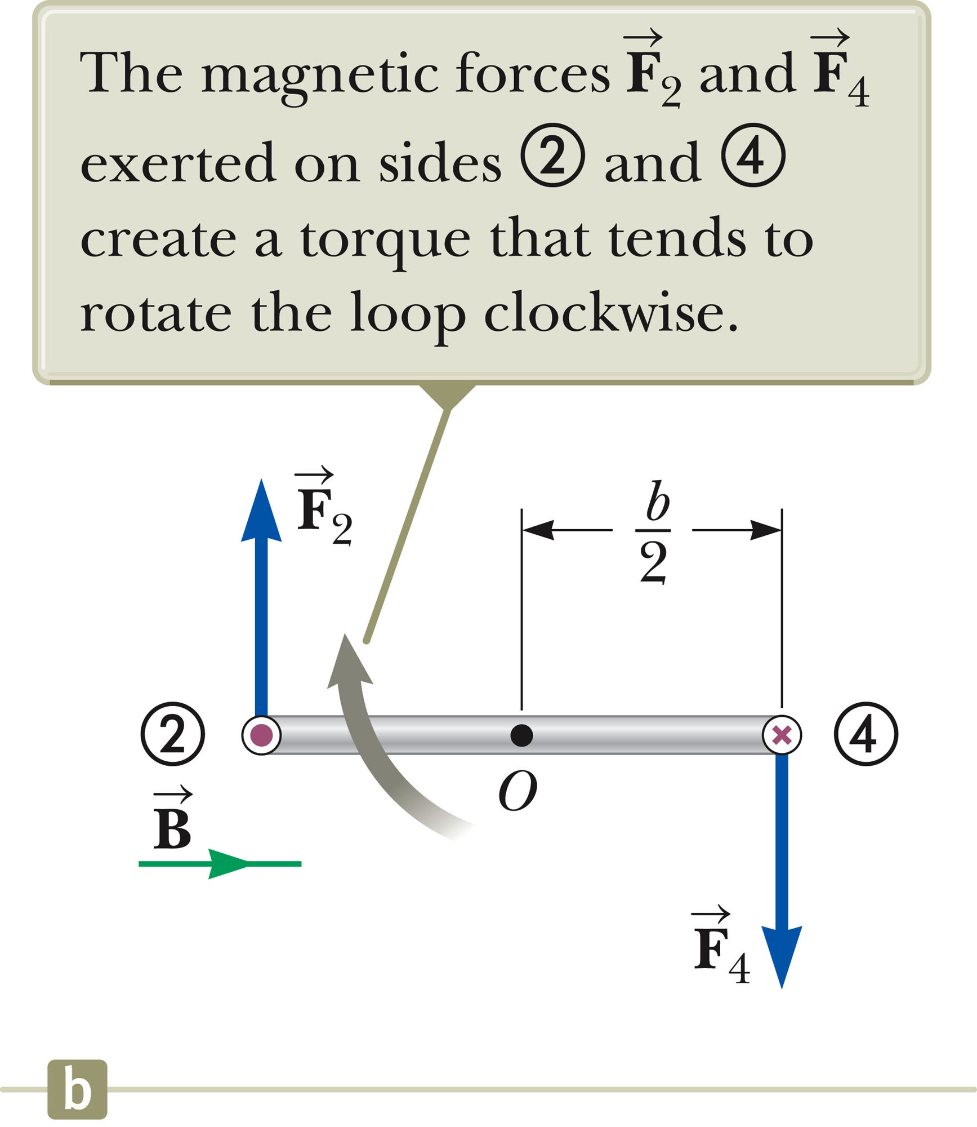
Torque on a Current Loop, 3
The forces are equal and in opposite directions, but not along the same line of action.
The forces produce a torque around point O.
Section 29.5

Slide 54
Torque on a Current Loop, Equation
The maximum torque is found by:
The area enclosed by the loop is ab, so τ_{max} = IAB.
  This maximum value occurs only when the field is parallel to the plane of the loop.
Section 29.5

Slide 55
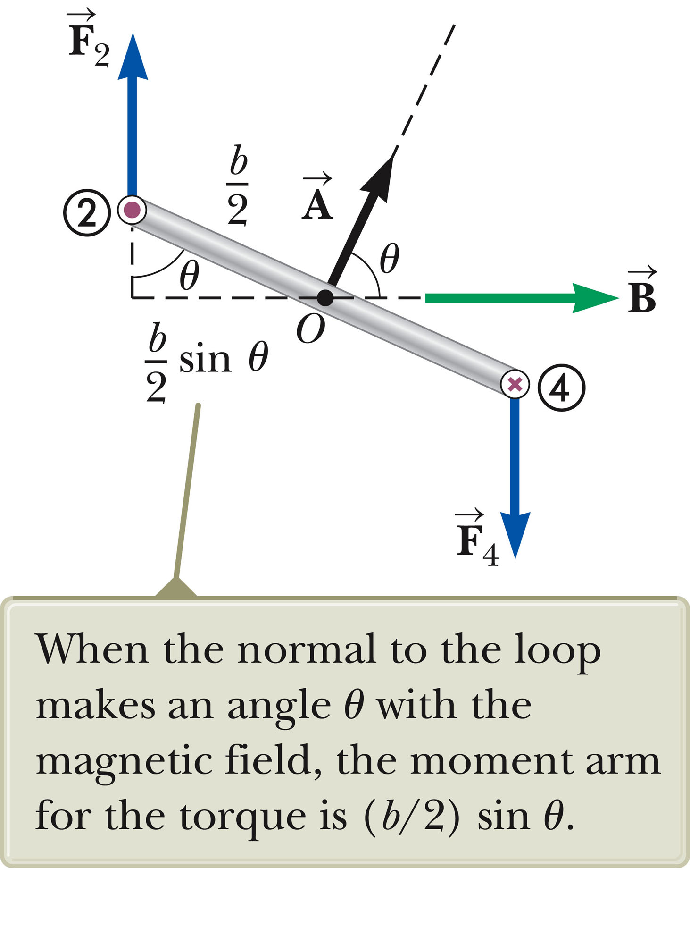
Torque on a Current Loop, General
Assume the magnetic field makes an angle of θ < 90º with a line perpendicular to the plane of the loop.
The net torque about point O will be τ = IAB sin θ.
Section 29.5

Slide 56
Torque on a Current Loop, Summary
The torque has a maximum value when the field is perpendicular to the normal to the plane of the loop.
The torque is zero when the field is parallel to the normal to the plane of the loop.
  is perpendicular to the plane of the loop and has a magnitude equal to the area of the loop.
Section 29.5

Slide 57
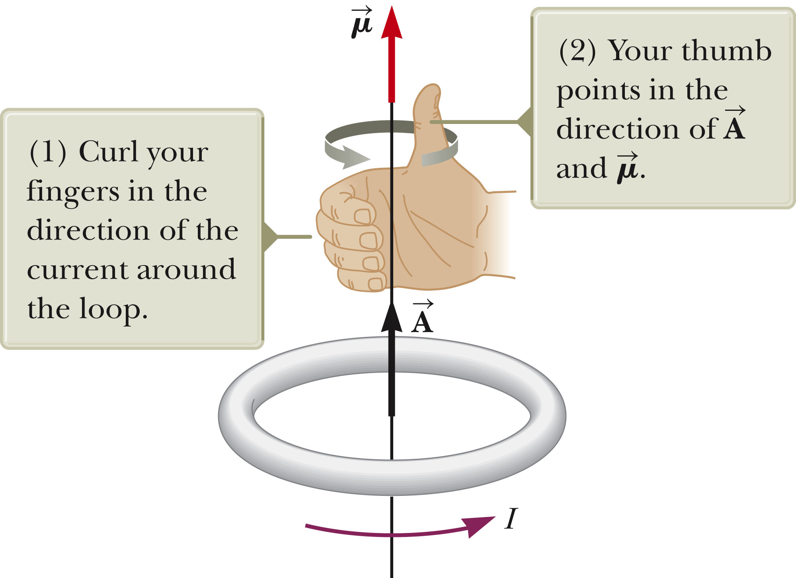
Direction
The right-hand rule can be used to determine the direction of .
Curl your fingers in the direction of the current in the loop.
Your thumb points in the direction of .
Section 29.5

Slide 58
Magnetic Dipole Moment
The product I is defined as the magnetic dipole moment, , of the loop.
  Often called the magnetic moment
SI units: A · m²
Torque in terms of magnetic moment:
  Analogous to for electric dipole
  Valid for any orientation of the field and the loop
  Valid for a loop of any shape
Section 29.5

Slide 59
Potential Energy
The potential energy of the system of a magnetic dipole in a magnetic field depends on the orientation of the dipole in the magnetic field given by
  U_{min} = -μB and occurs when the dipole moment is in the same direction as the field.
  U_{max} = +μB and occurs when the dipole moment is in the direction opposite the field.
Section 29.5

Slide 60
Hall Effect
When a current carrying conductor is placed in a magnetic field, a potential difference is generated in a direction perpendicular to both the current and the magnetic field.
This phenomena is known as the Hall effect.
It arises from the deflection of charge carriers to one side of the conductor as a result of the magnetic forces they experience.
The Hall effect gives information regarding the sign of the charge carriers and their density.
It can also be used to measure magnetic fields.
Section 29.6

Slide 61
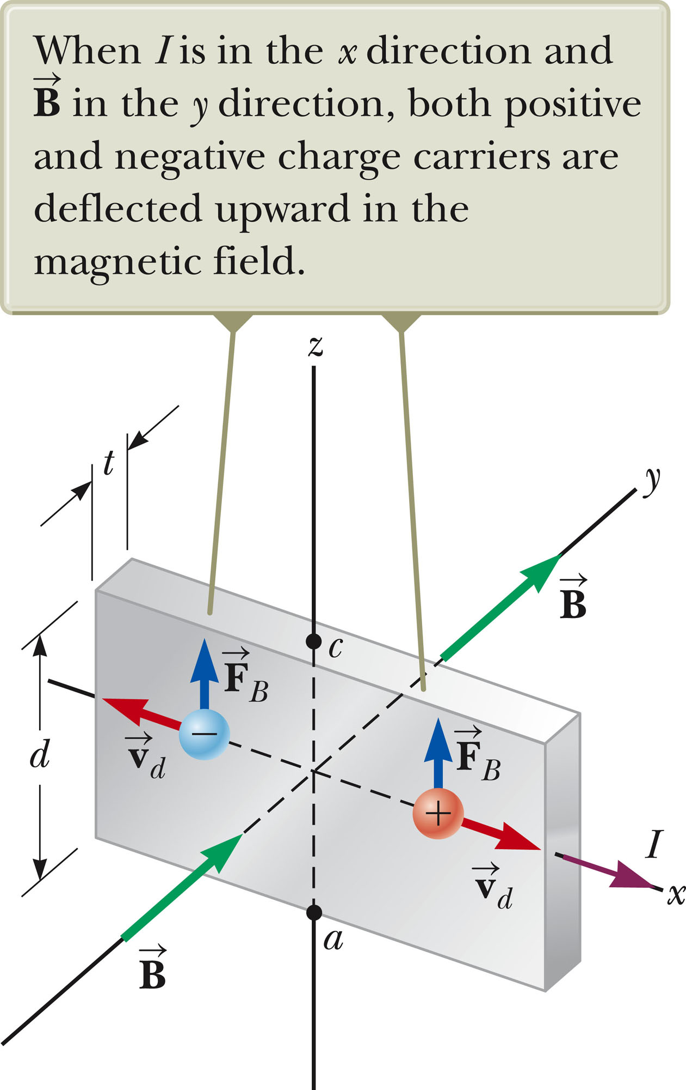
Hall Voltage
This shows an arrangement for observing the Hall effect.
The Hall voltage is measured between points a and c.
Section 29.6

Slide 62
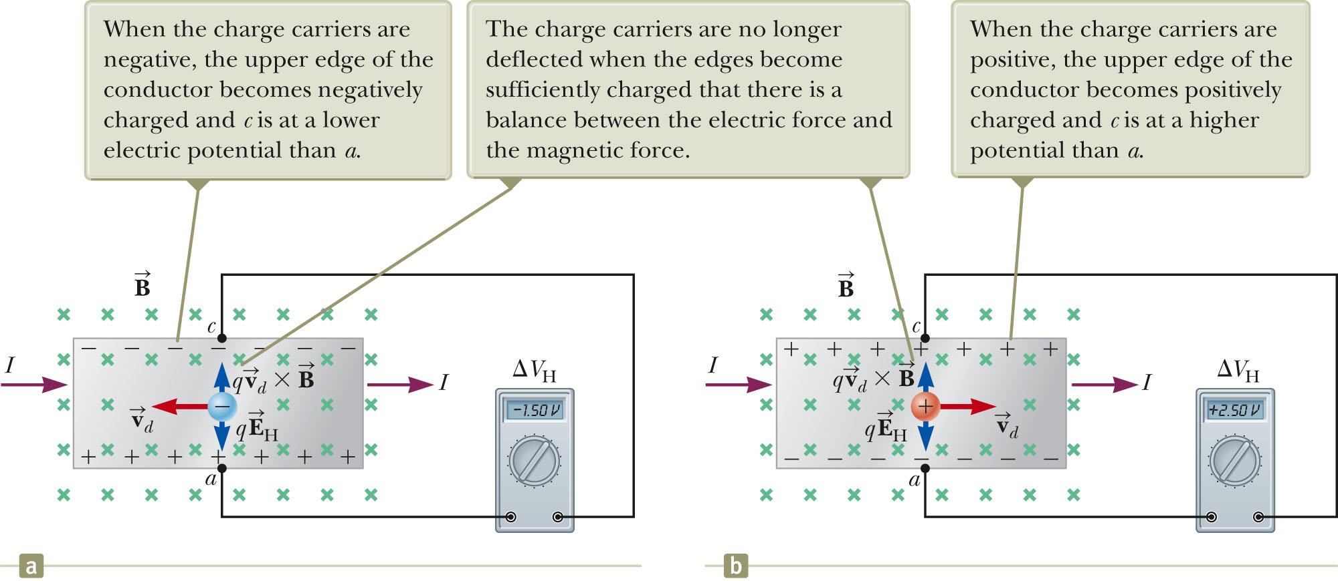
Hall Voltage, cont.
When the charge carriers are negative, they experience an upward magnetic force, they are deflected upward, an excess of positive charge is left at the lower edge.
This accumulation of charge establishes an electric field in the conductor.
It increases until the electric force balances the magnetic force.
If the charge carriers are positive, an excess of negative charges accumulates on the lower edge.
Section 29.6

Slide 63
Hall Voltage, final
ΔV_{H} = E_{H}d = v_{d} B d
  d is the width of the conductor
  v_{d} is the drift velocity
  If B and d are known, v_{d} can be found
  R_{H} = 1 / nq is called the Hall coefficient.
  A properly calibrated conductor can be used to measure the magnitude of an unknown magnetic field.
Section 29.6

